Slide 1
MRI CRITERIA
Physical Characteristics
Lesion location
Lesion size
Condylar size
Other Knee Features
Physeal patency
Joint effusion
Cartilage
Thickness of overlying cartilage
Articular surface contour
Status of overlying articular cartilage
Status of un-ossified epiphyseal cartilage (Omen Sign)
Interfaces
Interface between cartilage and bone – Oreo Cookie Sign
Measurement of crème
Signal characteristics of interface
Mineralization within the Progeny
Presence of mineralization within the progeny
Measurement of mineralization
Parent Bone
Distinct round or oval hyper-intense foci (deep to top wafer)
Confluent band of signal in the Parent Bone
Marrow edema Pattern
Discontinuity in Mineralization Front

Slide 2
MRI PROTOCOL
Axial FSE (TSE) T2 with fat saturation
Coronal T1
Coronal FSE (TSE) T2 with fat saturation*
Sagittal FSE (TSE) T2 with fat saturation*
Sagittal FSE (TSE) proton density*
Sagittal volumetric gradient echo with fat saturation*
* mandatory sequence (minimal protocol) to focus upon juvenile OCD

Slide 3
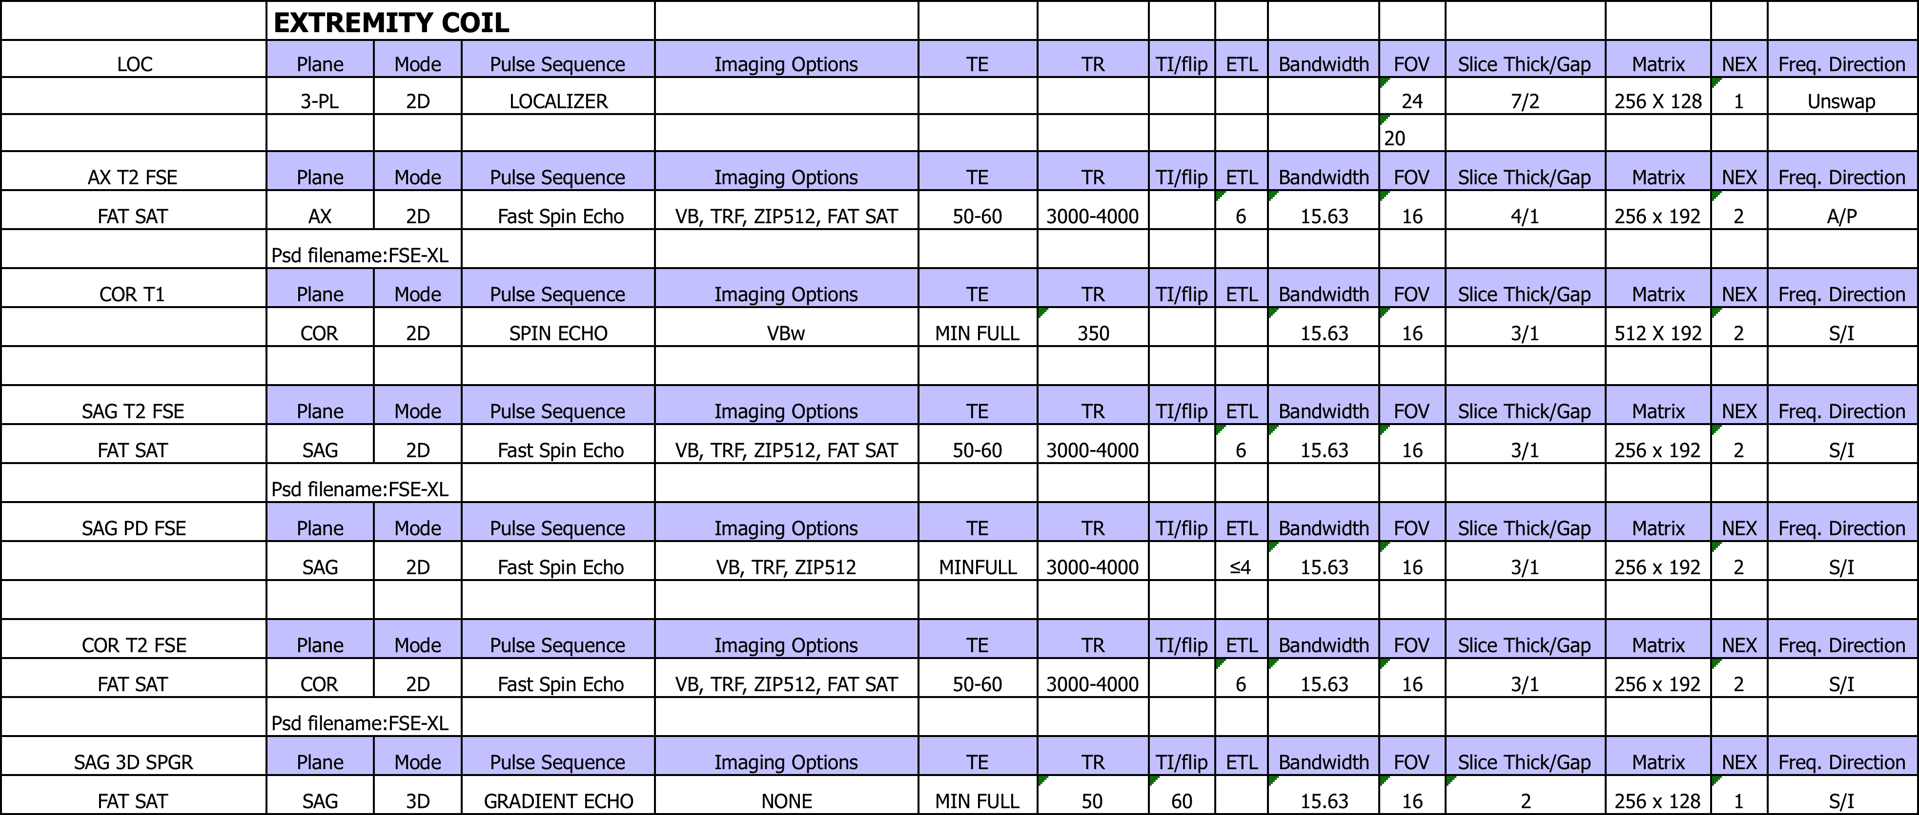
MRI PROTOCOL DETAILS FOR 1.5T

Slide 4
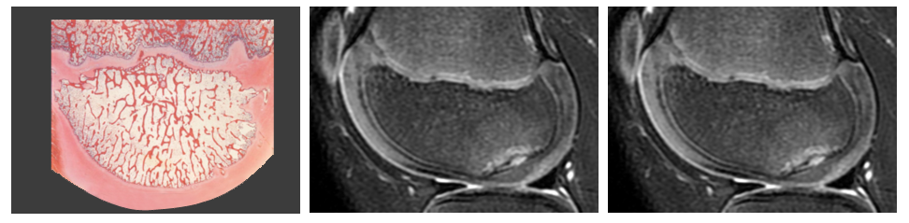
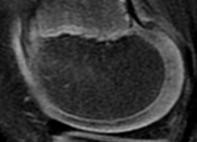




HISTOLOGY / IMAGING CORRELATES
Histology
Normal MRI
OCD MRI
Mineralization front
Secondary physis
Unossified epiphyseal cartilage
Articular cartilage
Notes:
NEED:
1 -Histology slide
2 –normal MRI Sagittal

Slide 5
Physical Characteristics

Slide 6
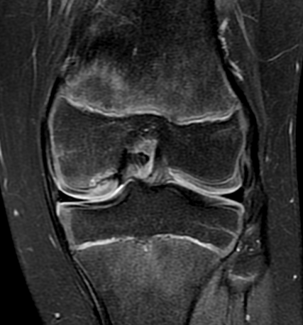
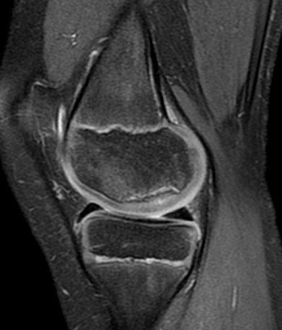
Physical Characteristics CRITERION 1 – LOCATION OF THE LESION
Coronal - divide into thirds
Sagittal - divide into thirds
1
2
3
3
2
1
1
2
3
1 - lateral or medial-most
2 - central
3 - intercondylar
1 - anterior
2 - central
3 - posterior
Measure in thirds on both sagittal and coronal
Base upon the width of the condyle (including bone and cartilage)
Many lesions will span 2 thirds, and some may span 3 thirds.
If lesion spans more than one zone, indicate/score all zones in which lesion resides - eg. (1, 1 & 2 or 1 & 2 & 3)

Slide 7
Physical Characteristics CRITERION 2 –SIZE OF THE LESION
WIDTH
T2 FSE FS Coronal
T2 FSE FS Sagittal
Measure maximal width from bone edge to bone edge (in mm)
Measure maximal length from bone edge to bone edge (in mm)

Slide 8
Physical Characteristics CRITERION 2 –SIZE OF THE LESION
DEPTH – EXAMPLE 1 (NO OREO COOKIE OR MINERALIZATION)
T2 FSE FS Coronal
T2 FSE FS Sagittal
Measure maximal depth from deep black line of parent bone to articular surface (in mm)
Measure maximal depth from deep black line of parent bone to articular surface (in mm)
Notes:
New slides.
Agree to measure from the cartilage and bone to the black line at the interface

Slide 9
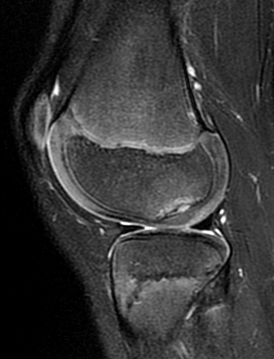
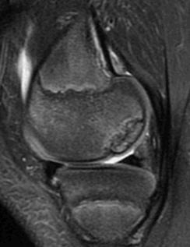
Physical Characteristics CRITERION 2 –SIZE OF THE LESION
DEPTH – EXAMPLE 2 (OREO COOKIE AND MINERALIZATION)
T2 FSE FS Sagittal
T2 FSE FS Sagittal
Measure maximal depth from deep black line of parent bone (top wafer of oreo cookie, not the bottom wafer of oreo cookie)
Measure maximal depth from deep black line of parent bone; skip past progeny bone (in mm)
QUESTION CASES

Slide 10
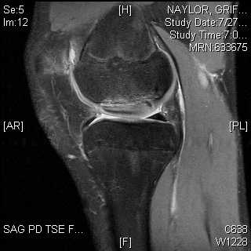
Physical Characteristics CRITERION 2 –SIZE OF THE LESION
DEPTH – EXAMPLE 3 (PROUD CARTILAGE)
T2 FSE FS Sagittal
Proud cartilage: Measure depth from deep black line of parent bone to imaginary line of normal articular cartilage (in mm)
Notes:
This case highlights some of the difficulties with measurement.
May be best to just measure full thickness of cartilage

Slide 11
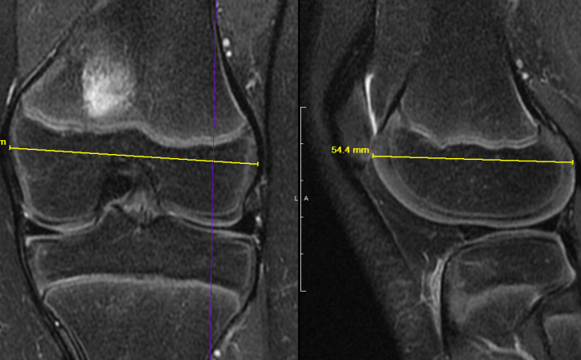
Physical Characteristics CRITERION 3 – CONDYLAR SIZE
Proud cartilage: Measure depth from deep black line of parent bone to imaginary line of normal articular cartilage (in mm)
Coronal and sagittal measure widest diameter of the epiphysis including unossified cartilage (try to keep line relatively horizontal)
Choose coronal slice showing intercondylar notch; measure at top of notch
Choose sagittal slice at central part of affected condyle (want widest diameter possible, don’t have to see OCD within slice chosen)
Notes:
Will not always have crème with fluid signal, but may have higher intensity signals.
JUTTA – need to be as simple as possible. Black line on both sides of higher intensity signal - + Oreo cookie sign.
Andy – when we see this, we should measure the length.
Normalize size to make analytics easier – will review at next meeting
Andy will add more slides on criteria and length measurement
How do we select the appropriate width?
Condyle measurement has been reliable in previous studies.
Measurements will be bone to bone, not cartilage to cartilage
Should move this measurement to the beginning.
Measurements of condyle width, and length/width of lesion should be done separately
Line of width should be roughly parallel to growth plate? Easier to do this coronal than sagittal? Will have to check this on first round of study with test group

Slide 12
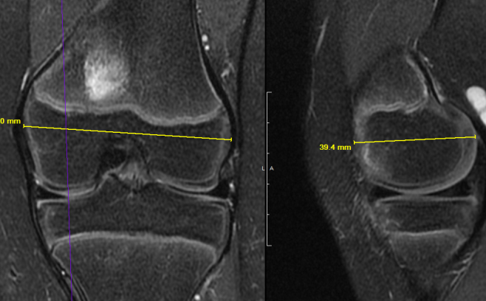
Physical Characteristics CRITERION 3 – CONDYLAR SIZE
Proud cartilage: Measure depth from deep black line of parent bone to imaginary line of normal articular cartilage (in mm)
Medial compartment example
Medial compartment can appear more truncated on sagittal images; measure widest diameter on sagittal image of affected compartment
Notes:
Will not always have crème with fluid signal, but may have higher intensity signals.
JUTTA – need to be as simple as possible. Black line on both sides of higher intensity signal - + Oreo cookie sign.
Andy – when we see this, we should measure the length.
Normalize size to make analytics easier – will review at next meeting
Andy will add more slides on criteria and length measurement
How do we select the appropriate width?
Condyle measurement has been reliable in previous studies.
Measurements will be bone to bone, not cartilage to cartilage
Should move this measurement to the beginning.
Measurements of condyle width, and length/width of lesion should be done separately
Line of width should be roughly parallel to growth plate? Easier to do this coronal than sagittal? Will have to check this on first round of study with test group

Slide 13
Other Knee Features

Slide 14
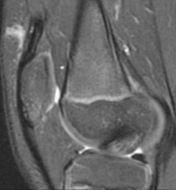
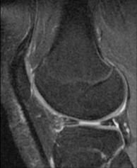
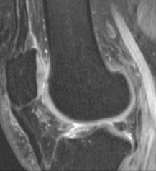
Other Knee Features CRITERION 1 –PHYSEAL PATENCY
Open
Closing
Closed
1 - Open
cartilage signal across
entire femur
2 - Closing
incomplete cartilage signal on any image
3 - Closed
no cartilage signal
Physis to be determined on FSE T2 FS or GRE FS
Sagittal sequence only, not coronal

Slide 15
Other Knee Features CRITERION 2 – JOINT EFFUSION
Joint Effusion
None
Grade 1 – Small
Grade 2 - Large
None – small fluid, but no saddlebag appearance in gutters or patella lifted off femur
Grade 1 – saddlebag fluid in the gutters
Grade 2 – patella lifted off femur on one slice above trochlear cartilage
Notes:
4-15. discussion was to have 3 categories. None, small, Large, or 0, 1, 2.
Rather than 4 categories. 0.1.2.3
Does effusion matter? Jutta – why do we include this?
Eric – important sign for instability, prognosis for healing
Presence of effusion may be important for prediction of not healing.
What about cases of popliteal cyst?
Having as few categories as possible is best for reliability
Andy can create slides that distinguish the categories. 0, 1, 2. Absent, Present, Present with Patella Liftoff.
Best to find one sequence/slice for measurement
We measure effusion on sagittal radiographs. Should we do the same on MRI?
Does normal or small effusion matter?
Best imaging is T2. If you want 3 categories, need sagittal and axial.

Slide 16
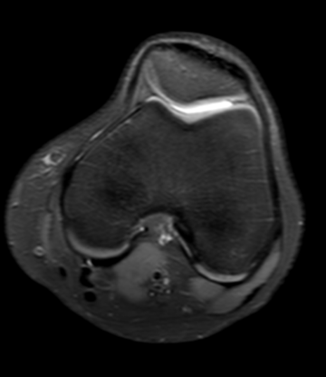
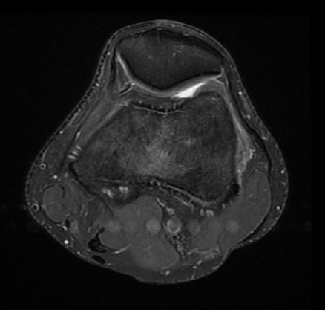
Other Knee Features CRITERION 2 – JOINT EFFUSION
– ODA CLASSIFICATION
None
None- fluid does not distend the lateral gutters
Notes:
Updated from last meeting
No saddlebags or liftoff

Slide 17
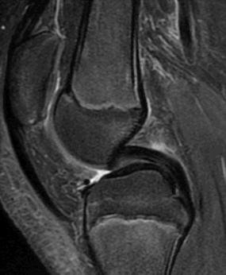
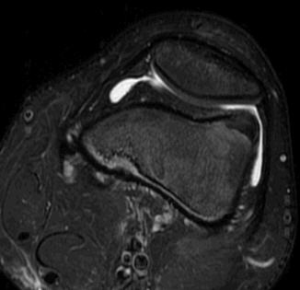
Other Knee Features CRITERION 2 – JOINT EFFUSION
Grade 1 – evaluate on axial images
Small – Saddlebag appearance of gutters on axial images (yellow arrows); no lifting off of patella from femur on the image above the trochlear cartilage (red line on sagittal image shows level of axial slice)
Notes:
Updated from last meeting
Could summarize
Small saddlebags, no liftoff

Slide 18
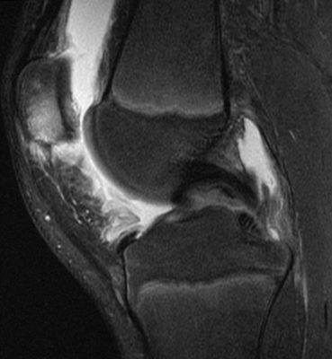
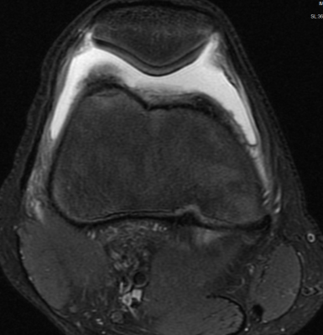
Other Knee Features CRITERION 2 – JOINT EFFUSION
Grade 2 – evaluate on axial images
Large – Lifting of patella anteriorly off femur on axial image above trochlear cartilage (red line on sagittal image shows level of axial slice)
Notes:
Lift off and saddle bags

Slide 19
Cartilage

Slide 20
CRITERION 1 – THICKNESS OF THE CARTILAGE OVERLYING THE LESION
T2 Coronal
T2 Sagittal
1 - Normal
2 - Thickened
3 - Thinned
4 - Variable
1 - Normal
2 - Thickened
3 - Thinned
4 - Variable
Red line is adjacent cartilage. Yellow Line is cartilage overlying the lesion.
Overlying cartilage = secondary physis, articular cartilage, un-ossified epiphyseal cartilage
Any portion of overlying cartilage of lesion is thicker or thinner than the adjacent normal cartilage
If overlying cartilage is both thickened and thinned – it should be scored as variable

Slide 21
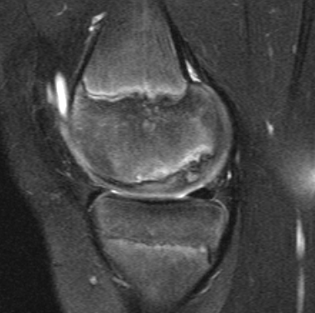
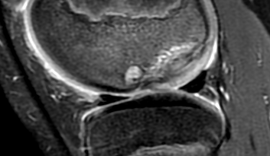
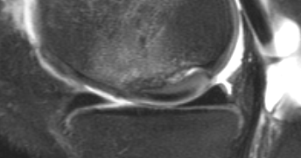
CRITERION 2 – ARTICULAR SURFACE CONTOUR
Normal Contour
Abnormal
Abnormal
1 – Normal on all images
Coronal and Sagittal
2 – Abnormal: proud, depressed, or both

Slide 22
CRITERION 2 – ARTICULAR SURFACE CONTOUR
Normal Contour
Abnormal
Abnormal - proud
1 – Normal on all images
Coronal and Sagittal
2 – Abnormal

Slide 23
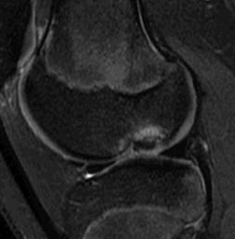
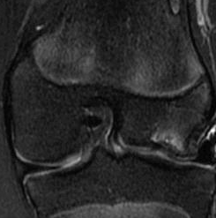
CRITERION 2 – ARTICULAR SURFACE CONTOUR
Abnormal
Abnormal
Same patient sagittal and coronal

Slide 24
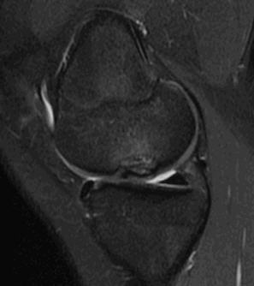
CRITERION 2 – ARTICULAR SURFACE CONTOUR
Abnormal
Abnormal
Abnormal - proud
Subtle contour abnormality
Subtle contour abnormality
Notes:
Would it be best to say
Abnormal contour versus normal contour
Not sure if depressed versus proud matters? Perhaps any contour disruption is the most important variable, that can be most reliable measured
If we have poor reliability – have to throw out
Contour
Normal
Abnormal
A 2 level variable more likely to be reliable
A three level approach could be used, and could be collapsed to 2 level.
Normal
Abnormal depressed
Abnormal proud

Slide 25
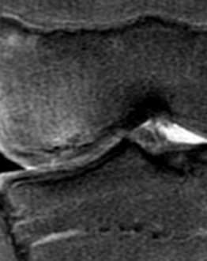
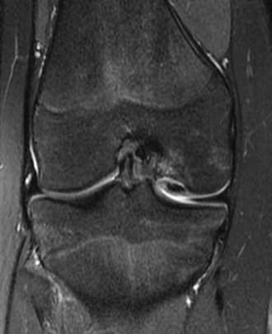
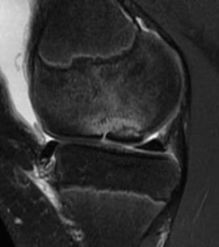
CRITERION 3 – STATUS OF OVERLYING CARTILAGE: BREACH OR NO BREACH
T2 FS Coronal
T2 FS Coronal
T2 FS Sagittal
not intact
not intact
not intact
2 - Not Intact
2 – Not intact
2 – Not intact
  Fissure with increased signal through articular +/- unossified cartilage
  1 = intact 2 = not intact
  Not intact: Breach = Fissure = Discontinuity
Notes:
What criteria do we use
Omen/Black Line
Higher intensity/bright line
Jutta
Use
Breech = fissure and/or discontinuity
Dark Line – not sure what this means
No Breech
With Bright line/signal on T2.

Slide 26
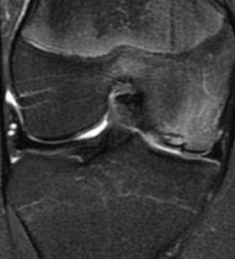
CRITERION 4 – STATUS OF UNOSSIFIED EPIPHYSEAL CARTILAGE (OMEN SIGN)
T2 Sagittal
Need image
Omen Sign
Omen Sign
Omen sign is an oblique or perpendicularly oriented, hypo-intense or dark signal line in the epiphyseal cartilage
Omen sign may be seen on coronal or sagittal images and should be scored as present if seen
Notes:
Andy – will send better examples of this for our next meeting. Done 6.2.15.

Slide 27
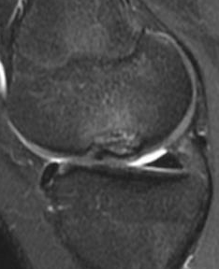
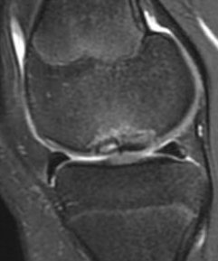
CRITERION 4 – STATUS OF UNOSSIFIED EPIPHYSEAL CARTILAGE (OMEN SIGN)
ADDITIONAL EXAMPLES
T2 Sagittal
Need image
Omen Sign
Omen Sign
Omen sign is an oblique or perpendicularly oriented, hypo-intense or dark signal line in the epiphyseal cartilage
Omen sign may be seen on coronal or sagittal images and should be scored as present if seen
Notes:
Andy – will send better examples of this for our next meeting

Slide 28
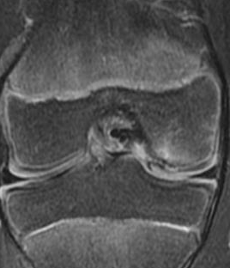
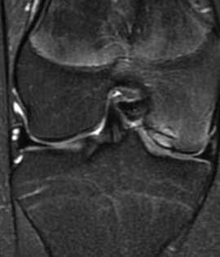
CRITERION 4 – STATUS OF UNOSSIFIED EPIPHYSEAL CARTILAGE (OMEN SIGN)
ADDITIONAL EXAMPLES
T2 Sagittal
Need image
Omen Sign
Omen Sign
Omen sign is an oblique or perpendicularly oriented, hypo-intense or dark signal line in the epiphyseal cartilage
Omen sign may be seen on coronal or sagittal images and should be scored as present if seen
Notes:
Andy – will send better examples of this for our next meeting. Done 6.2.15
Omen sign – may be a ‘pre-break’ or ‘pre-breech”
Precursor to an unstable lesion.

Slide 29
Interfaces

Slide 30
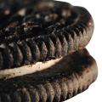
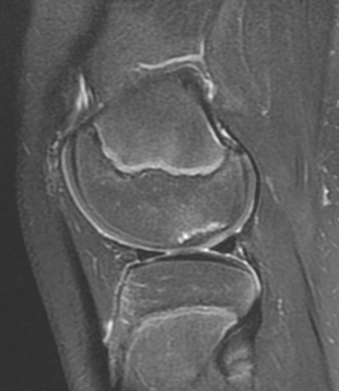
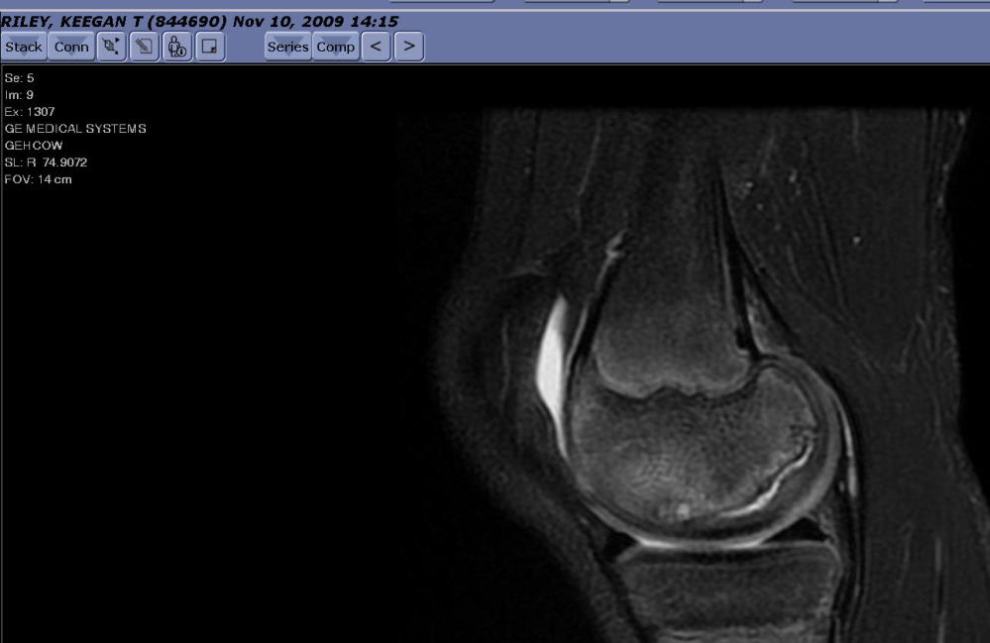
CLARIFICATION – Parent Bone CRITERION VS Interface CRITERION
Hyperintense signal deep to cookie wafer – i,e. within Parent Bone
NO OREO COOKIE
Hyperintense signal superficial to cookie wafer – i.e. at interface between Progeny and Parent bone
OREO COOKIE
Mineralization front superficial to high signal
Mineralization front (top wafer) deep to high signal
Slide is meant to qualitatively distinguish between the hyper-intense signal in the “parent” bone (Left) and the hyper-intense signal at the interface between progeny and parent bone, the “crème” (Right).
Notes:
Andy believes these signal differences are critical for JOCD.
The finding on the R slide is thought to be more ominous than those on the Left

Slide 31
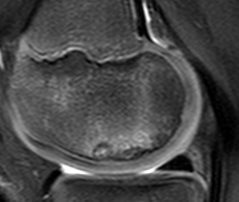
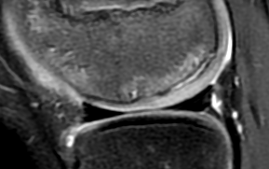
CRITERION 1– INTERFACE BETWEEN CARTILAGE AND BONE – OREO COOKIE SIGN
No Increased Signal
1 – No Hyperintense Signal at Interface = No Oreo Cookie Sign
2 – Hyperintense Signal at Interface = Oreo Cookie Sign
OREO COOKIE SIGN
  Between the parent bone and the cartilage, there is a ‘tri-laminar structure’ with 2 hypo-intense layers on the outside (wafers), and a hyperintense layer in between (crème)
  Oreo Cookie Sign may be seen on coronal and sagittal images and should be scored as present if seen
Notes:
Will not always have crème with fluid signal, but may have higher intensity signals.
JUTTA – need to be as simple as possible. Black line on both sides of higher intensity signal - + Oreo cookie sign.
Andy – when we see this, we should measure the length.
Normalize size to make analytics easier – will review at next meeting
Andy will add more slides on criteria and length measurement

Slide 32
CRITERION 2– MEASUREMENT – OREO COOKIE SIGN
No Increased Signal
1 – No Increased Signal
No Oreo Cookie Sign
2 – Increased Signal
Oreo Cookie Sign
OREO COOKIE SIGN
  If present, measure length of crème as shown (mm)
Notes:
Will not always have crème with fluid signal, but may have higher intensity signals.
JUTTA – need to be as simple as possible. Black line on both sides of higher intensity signal - + Oreo cookie sign.
Andy – when we see this, we should measure the length.
Normalize size to make analytics easier – will review at next meeting
Andy will add more slides on criteria and length measurement
How do we select the appropriate width?
Condyle measurement has been reliable in previous studies.

Slide 33
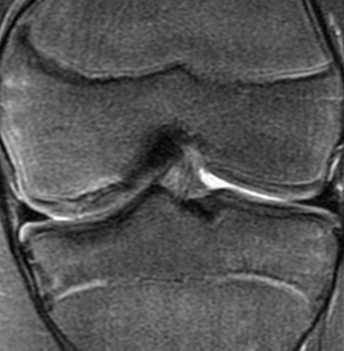
CRITERION 3– SIGNAL CHARACTERISTICS AT INTERFACE BETWEEN CARTILAGE AND BONE – OREO COOKIE SIGN
Interface predominantly less than fluid, but greater than tibial marrow
Oreo cookie, but with interface equal to tibial bone marrow
Interface predominantly equal to fluid
OREO COOKIE SIGN
  If present, record if interface is predominantly equal in signal to fluid, less than fluid but greater than bone marrow in the tibia, or equal to bone marrow of the tibia
  Compare to adjacent joint fluid
Notes:
Eric – maybe do this on a slider scale.

Slide 34
Mineralization within the Progeny

Slide 35
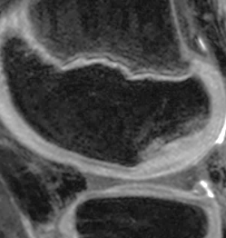
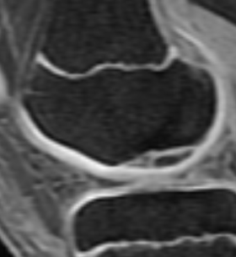
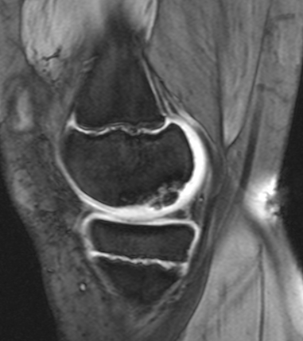
CRITERION 1 – PRESENCE OF MINERALIZATION WITHIN THE PROGENY
Sagittal 3D GRE
Sagittal 3D GRE
Sagittal 3D GRE
1 = None
3 – Predominantly multiple distinct fragments
3 – Predominantly multiple distinct fragments
On a gradient echo sequence, record presence and predominant pattern of mineralization:
1= none
2= Predominantly one distinct geographic fragment
3= Predominantly multiple distinct geographic fragments
4= Predominantly linear mineralization (continuous or discontinuous)
Notes:
Geographic means you can draw a line around the area of mineralization

Slide 36
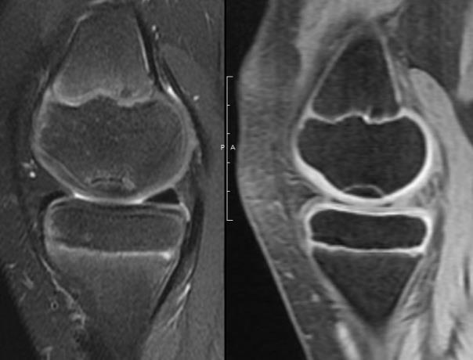
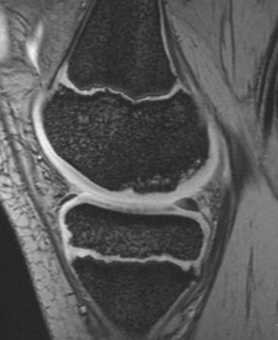
CRITERION 1 – PRESENCE OF MINERALIZATION WITHIN THE PROGENY
Sagittal 3D GRE
Sagittal 3D GRE
2 – Predominantly single distinct fragment
2 – Predominantly single distinct fragment
On a gradient echo sequence, record presence and predominant pattern of mineralization:
1= none
2= Predominantly one distinct geographic fragment
3= Predominantly multiple distinct geographic fragments
4= Predominantly linear mineralization (continuous or discontinuous)
Notes:
Linear versus lobular? Ask group

Slide 37
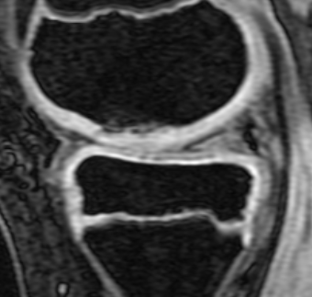
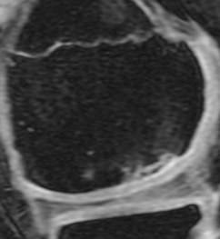
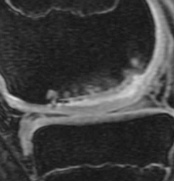
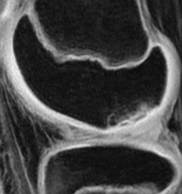
CRITERION 1 – PRESENCE OF MINERALIZATION WITHIN THE PROGENY
Sagittal 3D GRE
Sagittal 3D GRE
Sagittal 3D GRE
4 – Predominantly linear mineralization
4 – Predominantly linear mineralization
How to classify?
On a gradient echo sequence, record presence and predominant pattern of mineralization:
1= none
2= Predominantly one distinct geographic fragment
3= Predominantly multiple distinct geographic fragments
4= Predominantly linear mineralization (continuous or discontinuous)
Notes:
Linear versus lobular? Ask group

Slide 38
CRITERION 1 – PRESENCE OF MINERALIZATION WITHIN THE PROGENY
Sagittal T2 FS
Sagittal 3D GRE
Sagittal 3D GRE
1 - None
2 - Present
NOTE THAT FRAGMENTS CAN BE IMPOSSIBLE TO SEE ON T2-WEIGHTED IMAGES ALONE
Notes:
Bone best seen on Gradient Echo sequence
Bone may not be seen well on T2, and thus Gradient Echo is important
Peter
Change this to
None
One fragments
Multiple fragments

Slide 39
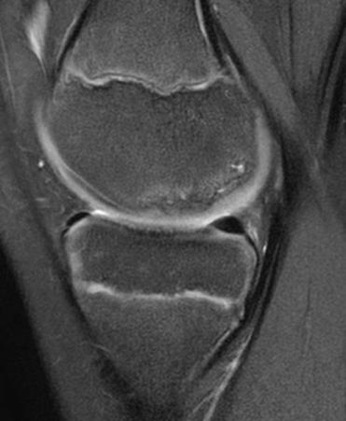
CRITERION 1 – PRESENCE OF MINERALIZATION WITHIN THE PROGENY
Sagittal T2 FS
Sagittal 3D GRE
NOTE THAT FRAGMENTS CAN BE IMPOSSIBLE TO SEE ON T2-WEIGHTED IMAGES ALONE
Notes:
Bone best seen on Gradient Echo sequence
Peter
Change this to
None
One fragments
Multiple fragments

Slide 40
CRITERION 2 – PRESENCE OF MINERALIZATION WITHIN PROGENY - SIZE
Sagittal 3D GRE
12 mm
Length in mm
If Mineralization Present within Progeny
Measure in mm in Maximal dimension on Sagittal and Coronal sequence
Measure either single fragment of entire conglomeration of ‘fragments’ for maximal dimension
Notes:
Keep this?

Slide 41
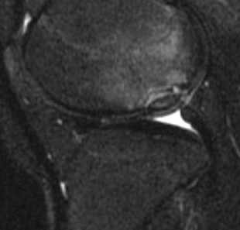

CRITERION 2 – INTERFACE BETWEEN PARENT BONE AND PROGENY BONE
T2 FS FSE Sagittal
Need image
1 – Interface signal predominantly less than fluid, but greater than tibial bone marrow
2 – Interface signal predominantly equal to fluid
If fragment is present on gradient echo image, evaluate interface between progeny mineralized fragment and parent bone on corresponding T2-weighted image
Record if interface is predominantly equal in signal to fluid, less than fluid but greater than bone marrow in the tibia, or equal to bone marrow of the tibia
If no progeny mineralization present – skip this criterion or score as non-applicable
Notes:
Tibial marrow is internal reference

Slide 42
Parent Bone

Slide 43
CLARIFICATION – Parent Bone CRITERION VS Interface CRITERION
Hyperintense signal deep to cookie wafer – i,e. within Parent Bone
Hyperintense signal superficial to cookie wafer – i.e. at interface between Progeny and Parent bone
Mineralization front superficial to high signal
Mineralization front (top wafer) deep to high signal
Slide is meant to qualitatively distinguish between the hyper-intense signal in the “parent” bone (Left) and the hyper-intense signal at the interface between progeny and parent bone, the “crème” (Right).
Notes:
Andy believes these signal differences are critical for JOCD.
The finding on the R slide is thought to be more ominous than those on the Left

Slide 44


CRITERION 1 – DISTINCT ROUND OR OVAL HYPER-INTENSE FOCUS IN THE PARENT BONE
T2 Coronal FS
T2 Sagittal FS
T2 Sagittal FS
round
round or oval
YES
YES
NO, this is a confluent band of hyperintense signal
Is hyperintense signal within the parent bone a distinct round or oval hyperintense focus? YES or NO
If yes, measure maximal dimension
If no, is the hyperintense signal within the parent bone a confluent band of hyperintense signal?
If yes, measure maximal dimension

Slide 45


CRITERION 1b – HYPER-INTENSE SIGNAL IN THE PARENT BONE - MEASUREMENT
T2 Sagittal
T2 Coronal
3 mm
7 mm
Length in mm
Length in mm
If Distinct Round or Oval Hyper-Intense Signal Present
Measure in mm in the Maximal dimension on Sagittal or Coronal sequence
If multiple areas of hyper-intense signal – measure largest focal area

Slide 46

CRITERION 2 – CONFLUENT BAND OF HYPERINTENSE SIGNAL IN THE PARENT BONE DEEP TO THE PROGENY INTERFACE
T2 Sagittal
NONE, only marrow edema pattern present
YES
Confluent band of hyperintense signal within parent bone on right
Can be seen on sagittal or coronal
When present, measure in maximal dimension

Slide 47
CRITERION 1 – CONFLUENT BAND OF HYPERINTENSE SIGNAL IN THE PARENT BONE DEEP TO THE PROGENY INTERFACE
T2 Sagittal
24 mm
In addition to the distinct round focus anterior, also has a confluent band of hyperintense signal more posterior
YES
When present, measure in maximal dimension

Slide 48

CRITERION 3 – MARROW EDEMA PATTERN IN PARENT BONE ADJACENT TO LESION
None or Minimal
Extensive
1 – None To Minimal
(less than 25% of
epiphysis involved)
2 – Extensive
(greater than 25% of
epiphysis involved)
Marrow Edema Pattern
Present in the parent bone adjacent to the progeny lesion
Choose sagittal image with greatest amount of edema to score

Slide 49



CRITERION 4 – DISCONTINUITY OF MINERALIZATION FRONT
Continuous
Single focus of discontinuity
Multiple foci of discontinuity
1 - None
2 - Single
3 - Multiple
1 - None
2 - Single
3 - Multiple
Artifactual decreased signal in cartilage
Mineralization front is continuous black line at interface between parent bone and progeny
Rate mineralization front as continuous, single focus of discontinuity, or multiple areas of discontinuity
Beware of artifactual decreased signal frequently seen in cartilage; consider tracing mineralization front from posterior to anterior
Choose worst from either coronal or sagittal images (continuous needs to be continuous on coronal and sagittal images)
No break
Single break
Multiple breaks

