Slide 1
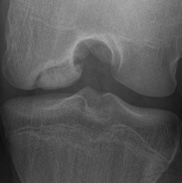
ROCK
(Research on Osteochondritis Dissecans of the Knee)
5th Annual Research Meeting
Denver, 2015
Kevin Shea, M.D.
St. Luke’s Health System
Boise, ID

Slide 2
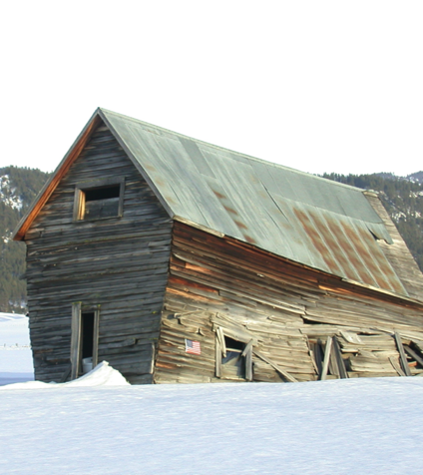
Study Group –
Osteochondritis Dissecans
Limited high quality clinical research published last 30 years
Vast majority of research is retrospective case review, and expert opinion

Slide 3
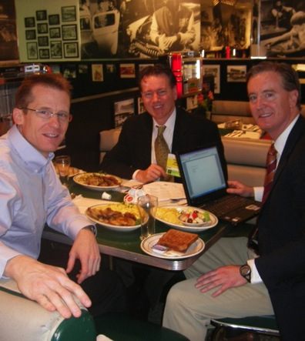
Osteochondritis Dissecans Research Group - History
OCD Research Group, aka ROCK Discussion 2009
  Ted Ganley
  Eric Wall
OCD Clinical Practice Guideline 2009-2010 – Core Group – Kurt Spindler recommended Jim Carey
First Meeting, Chicago, November 2010 – AAOS OREF Education Grant – Kristy Weber
ROCK Name – AOSSM 2011 Wright, Carey

Slide 4
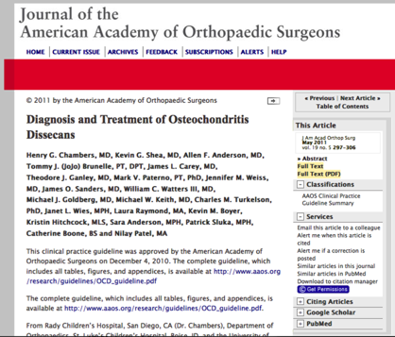
Osteochondritis Dissecans
2010 AAOS Clinical Practice Guideline for OCD of the Knee
  Identified the important clinical questions, and areas in need of more research
  Provides outline for future research
Perfect Opportunity for Research Group

Slide 5
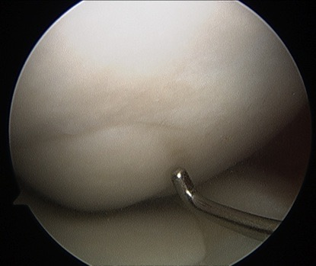
Goals - ROCK Group
Improve the quality of life in patients with this condition
Develop Optimal prevention and treatment strategies for OCD
Reduce Variation in Care
Notes:
----- Meeting Notes (1/25/13 13:58) -----
sadffasdf

Slide 6
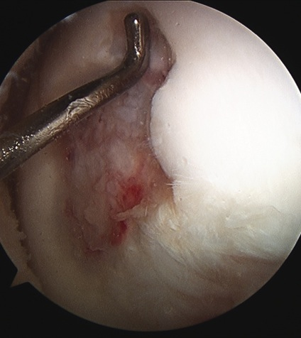
OCD Future Research Recommendations from CPG
Inter- and intra-observer reliability studies for radiographs, MRI, and arthroscopy classification
Prospective cohort studies to identify the independent predictors of healing
RCTs to establish the optimal surgical and nonsurgical treatment strategies

Slide 7
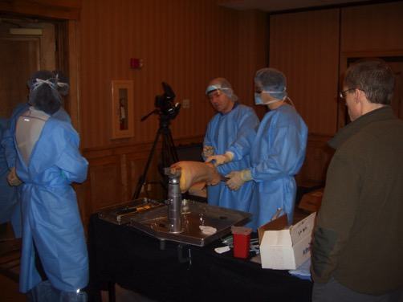
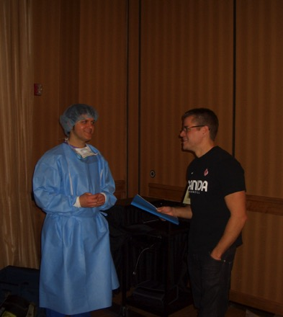
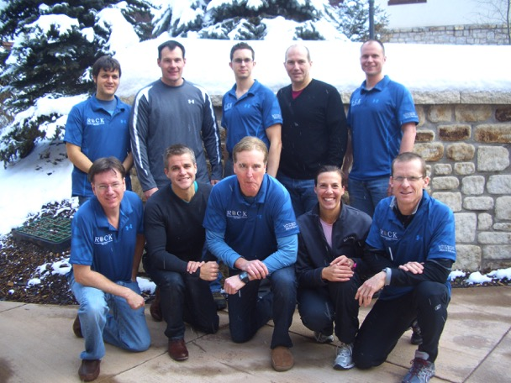
ROCK Vail/Denver Meeting 2011

Slide 8
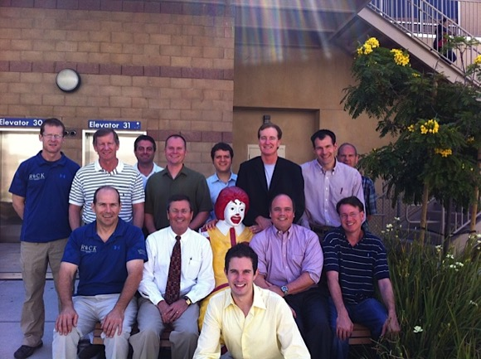
ROCK AOSSM 2011
Select Database
Commitment for Funding
Refine Research Questions

Slide 9
Osteochondritis Dissecans- Definition 2011
A focal, idiopathic alteration of sub-chondral bone with risk for instability and disruption of adjacent articular cartilage that may result in premature osteoarthritis
Published CORR 2013
  Edmonds Editorial

Slide 10

Osteochondritis Dissecans Research Group - Milestones
RCT – 2012
  Ben Heyworth
  2014 - Met AOSSM enrollment criteria – Barely!
ROCK Mission Statement 2013
  The Research on Osteochondritis Dissecans of the Knee (ROCK) Study Group is devoted to the investigation of etiology, diagnostic criteria, management, and optimization of physical activity for patients with OCD.
Prospective Cohort 2014
Instructional Course Lectures
  AAOS, AOSSM, POSNA 2011-2015

Slide 11
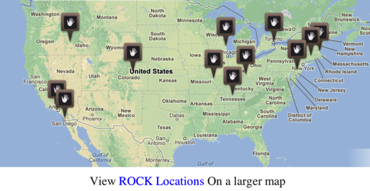
ROCK Centers 2009 - 2015
2009 - 3 ‘Centers’
2013 - 16 Centers, US, Canada, Singapore, Sweden, Germany
20 ORS, 3 MSK Radiologists, 2 PTs, 2 med students, PhD/ATC

Slide 12
ROCK Progress: Reliability Studies
Arthroscopy Classification | Self-Funded | Study Complete 2013 ICC Reliability Scores 0.91-.95 Presented AOSSM POSNA 2013. Publication Submission Pending
Healing Sequence | AOSSM Grant | Status. Ongoing. Completion 2015
X-ray Classification | AOSSM Grant | Completion Mid 2013. Published 1-2015
MRI Classification | AOSSM Grant | Completion 2016

Slide 13
ROCK Member Publications
CORR Symposium on OCD
  Edmonds
  Group
Publications on OCD (Jan 2015)
  79 total publications (up from 54 at Denver 2014)
  39 collaborative publications (more than 1 ROCK member; up from 20 at Denver 2014)

Slide 14
ROCK Research Fellowship 2014
Jake Jacobs
Funding – Anderson, Ganley, Shea
Utah Population Database OCD study – cross reference of diagnoses and family geneology records:
  Jacobs, Ganley, Anderson, Shea
  Ongoing.
OCD epidemiology studies at Kaiser-Permanente Southern California:
  Weiss, Kessler, Jacobs, Shea.
    OCD Knee
    OCD Other
    OCD Progression to Surgery
    OCD Adult
    OCD – Growth Hormone
-Multiple studies on pediatric knee ligament and physeal anatomy:
  Ganley, Shea, Anderson, Styhl, Jacobs

Slide 15
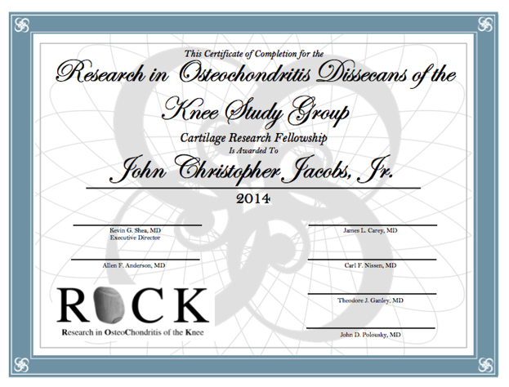

Slide 16
ROCK Research Fellowship 2015
2 superb applicants – first year medical students
Boise
  Summer 2015
Other Centers?

Slide 17

ROCK Future
Add Additional Centers
Treatment Variation Reduction
Prospective Cohort Studies and Expansion
Funding
  OREF
  Industry
AUC for OCD
Other

