Slide 1
Healing Sequence Studies 1 & 2
Official ROCK Rater Tutorial

Slide 2
Purpose of Study #1
To test the inter- and intra-rater reliability of OCD x-ray healing based on initial and final 2 year follow-up x-rays.
To compare inter- and intra-rater reliability of continuous and categorical scales of healing.
To determine the reliability of 6 sub-categories that may be important in determining OCD healing: sclerosis, size, ossification, boundary, overall healing.

Slide 3
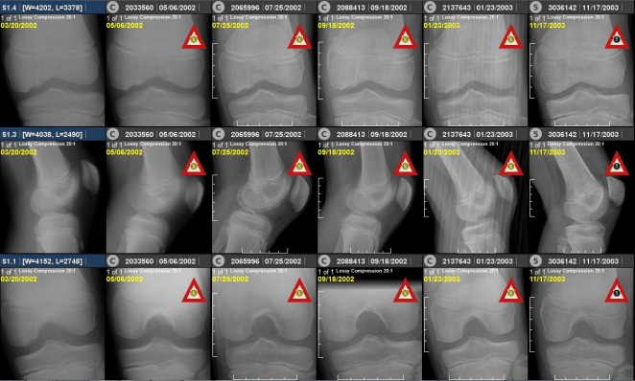
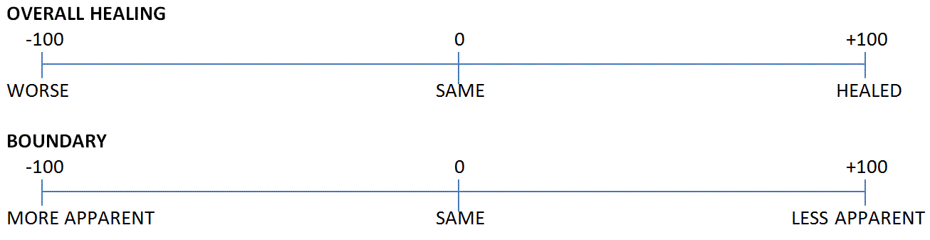
Study 1 – Overall Healing
(Continuous)
Overall healing – not defined. Up to the determination of the rater.
Compare the overall healing of the OCD lesion in the right column (final x-rays) to the left column (initial x-rays).
Take all images into account for your rating.
Click on slider bar and move to your rating. You must move the slider a bit to pick “0” or SAME.

Slide 4
Study 1 – Overall Healing
(Categorical)
Overall healing – not defined. Up to the determination of the rater.
Compare the overall healing of the OCD lesion in the right column (final x-rays) to the left column (initial x-rays).
Take all images into account for your rating.
Select rating.
completely unhealed
substantially unhealed
partially unhealed
same/no difference
partially healed
substantially healed
completely healed

Slide 5
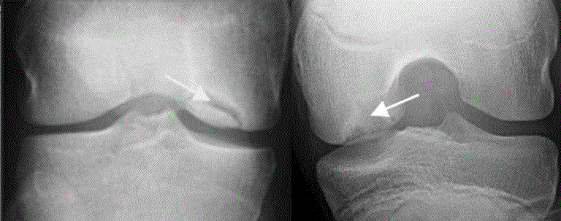
Study 1 – Boundary
Boundary – interface between the parent bone and progeny OCD lesion
Compare the appearance of the boundary in the right column (final x-rays) to the left column (initial x-rays).
Take all images into account for your rating.
Click on slider bar and move to your rating.
More apparent
Less apparent

Slide 6
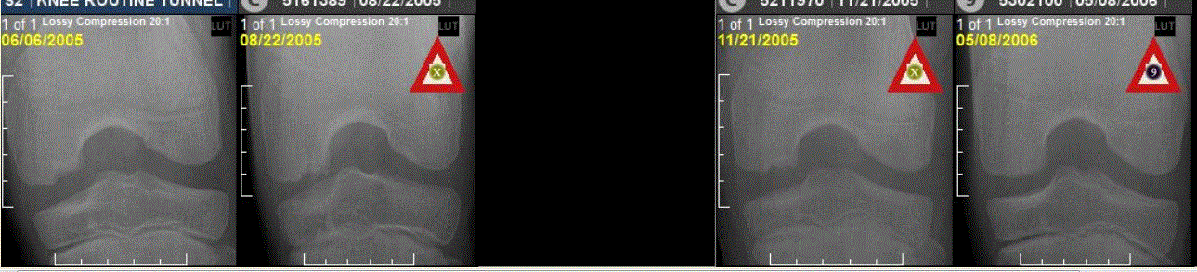
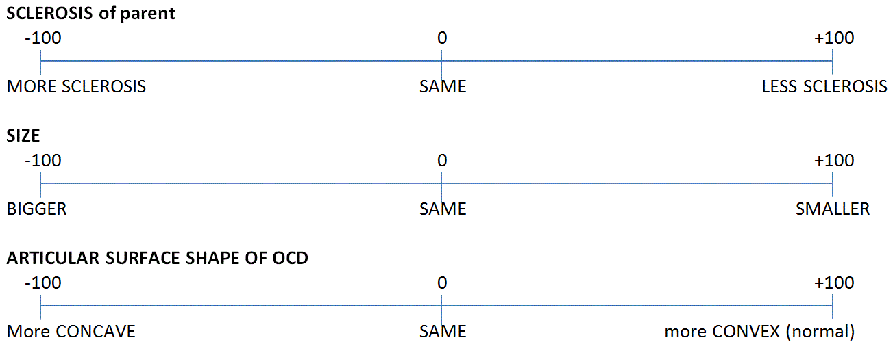
Study 1 – Lesion Size
Lesion Size - the overall volume of the lesion (including height, width, and depth)
Compare the lesion size in the right column (final x-rays) to the left column (initial x-rays).
Take all images into account for your rating.
Click on slider bar and move to your rating.

Slide 7
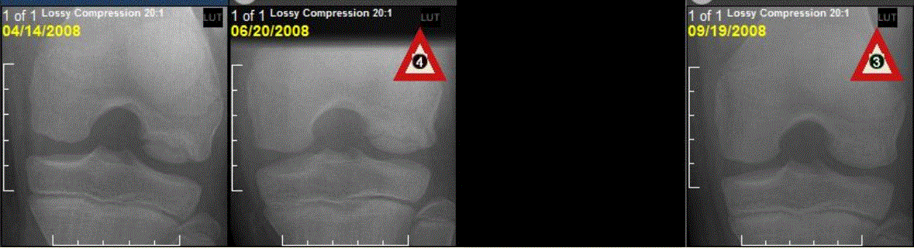
Study 1 – Sclerosis
Sclerosis - the high signal line of the parent bone that abuts the lesion (regardless of whether the progeny bone is visible).
Compare the parent sclerotic bone rim to the surrounding parent bone in the right column (final x-rays) to the left column (initial x-rays).
Take all images into account for your rating.
Click on slider bar and move to your rating.

Slide 8
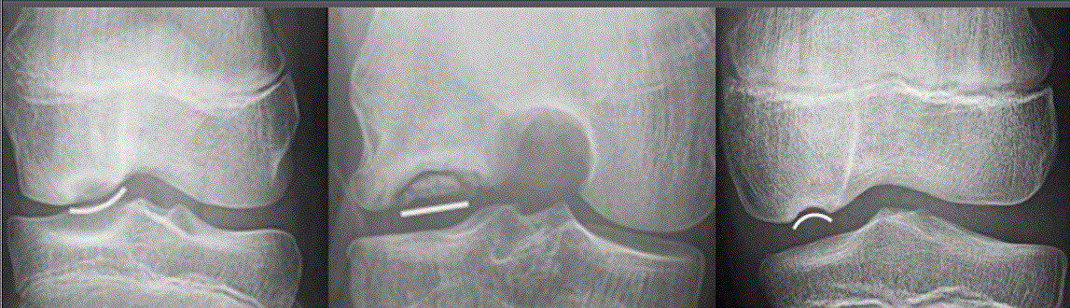
Study 1 – Contour
Surface contour - shape of the most superficial portion of the progeny bone when visible or the crater edge when the progeny bone is not visible.
Compare the surface contour in the right column (final x-rays) to the left column (initial x-rays).
Take all images into account for your rating.
Click on slider bar and move to your rating.
Concave Straight Convex

Slide 9
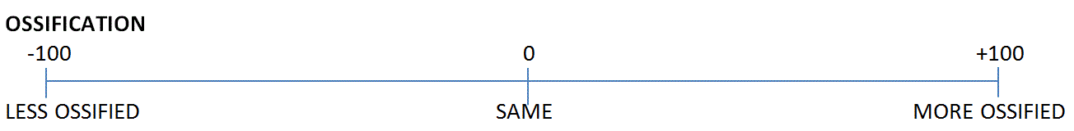
Study 1 – Ossification
Ossification - amount of bone formation in the OCD progeny region.
Compare the ossification in the right column (final x-rays) to the left column (initial x-rays).
Take all images into account for your rating.
Click on slider bar and move to your rating.

Slide 10
Purpose of Study #2
To determine inter- and intra-rater reliability of x-ray OCD healing at 5 time points (6 weeks, 12 weeks, 3 months, 1 year, 2 years) after the pre-treatment x-ray.
To determine the earliest point at which raters agree on healing.
To identify if healing on early x-rays predicts final healing at two years.

Slide 11
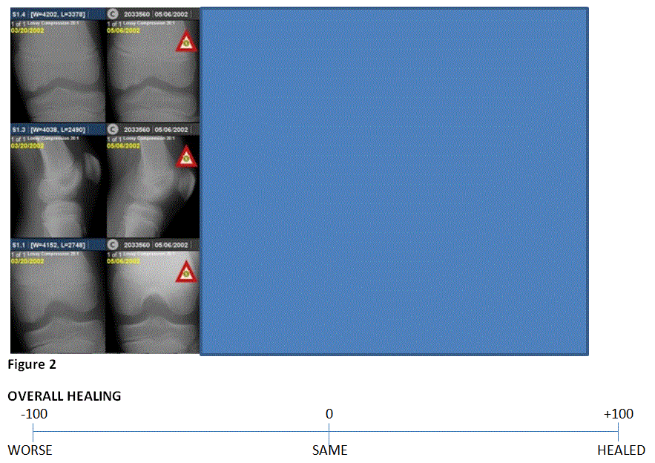
Title
Study 2 – Overall Healing
(Continuous)
Compare the right most column (most recent x-ray) to the preceding x-rays on the left to judge whether overall healing of the OCD lesion is worse, the same, or better.
Take all images into account for your rating.
Click on slider bar and move to your rating.
Text

Slide 12
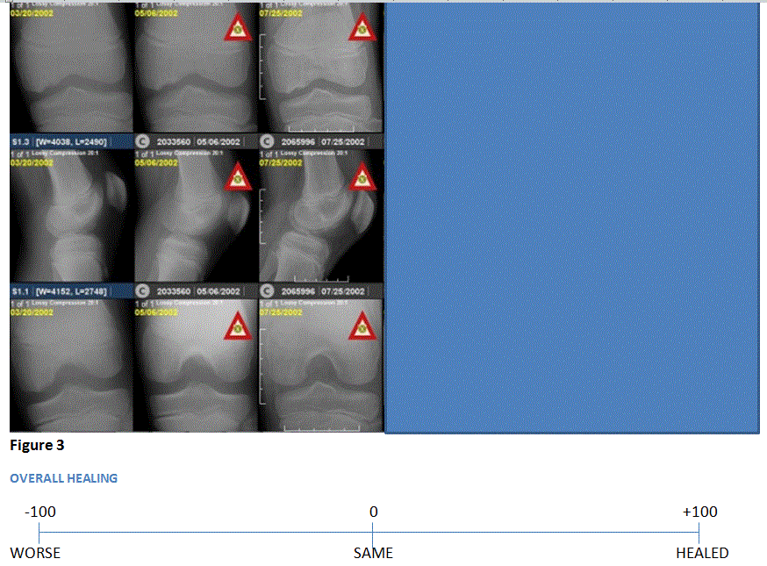
Title
Study 2 – Overall Healing
(Continuous)
Compare the right most column (most recent x-ray) to the preceding x-rays on the left to judge whether overall healing of the OCD lesion is worse, the same, or better.
Take all images into account for your rating.
Click on slider bar and move to your rating.
Text

Slide 13
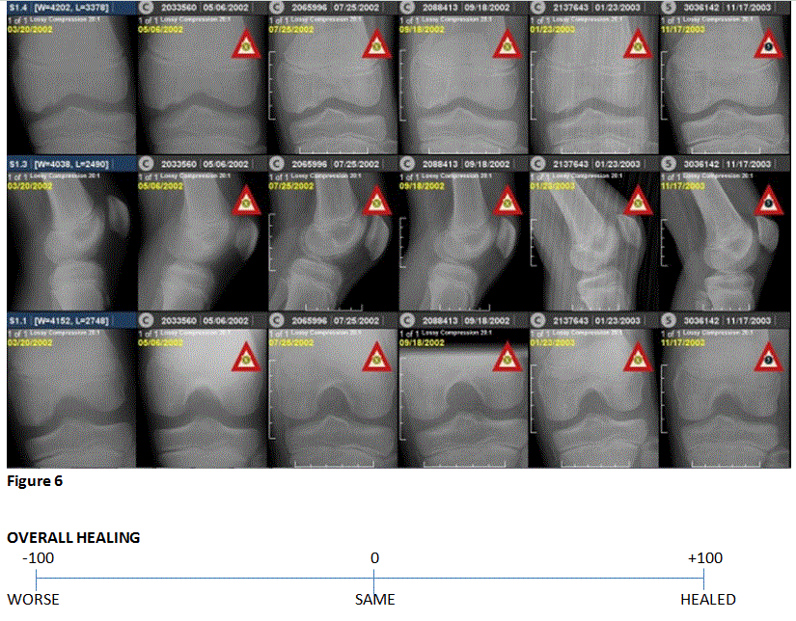
Title
Text

