Slide 1
OCD X-Ray Classification Reliability
ROCK Study Group

Slide 2
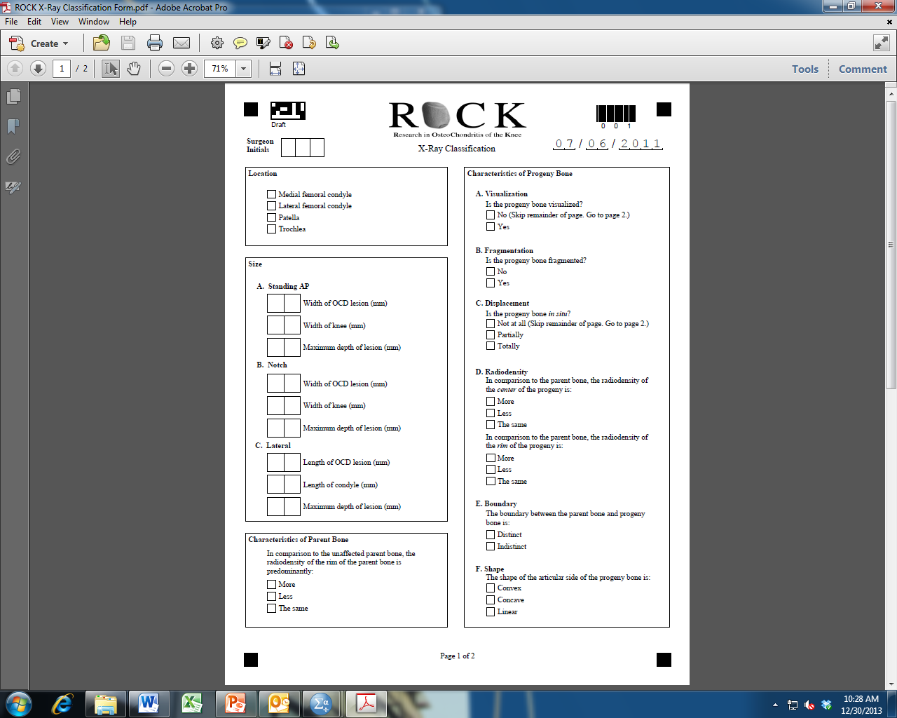
X-Ray Classification Form

Slide 3
OCD X-ray View
Most Visible OCD X-Ray View (AP/Lateral/Notch)
 | Κappa | % Agreement
INTERRATER | 0.65 | 42% (19/45)
INTRARATER | 0.69 | 83% (262/315)
Kappa Agreement
0.81-1 = excellent
0.61-0.8 = substantial
0.41-0.6 = moderate
0.21-0.4 = fair
0-0.2 = slight

Slide 4
Skeletal Maturity
Growth Plates (Open/Closing/Closed)
 | ICC | % Agreement
INTERRATER | 0.86 | 49% (22/45)
 | Kappa | % Agreement
INTRARATER | 0.84 | 86% (270/315)
Kappa Agreement
0.81-1 = excellent
0.61-0.8 = substantial
0.41-0.6 = moderate
0.21-0.4 = fair
0-0.2 = slight
ICC Agreement
0.75-1 = excellent
0.60-0.75 = good
0.40-0.59 = fair
0-0.39 = poor

Slide 5
OCD Location
OCD Location (Medial/Lateral)
 | Κappa | % Agreement
INTERRATER | 0.96 | 93% (42/45)
INTRARATER | 0.97 | 98% (310/315)
OCD Location (Anterior/Posterior/Not Visible)
 | Κappa | % Agreement
INTERRATER | 0.37 | 13% (6/45)
INTRARATER | 0.63 | 77% (244/315)
OCD Location (Anterior/Posterior) – all cases rated “not visible” excluded
 | Κappa | % Agreement
INTERRATER | 0.49 | 33% (6/18)
INTRARATER | 0.72 | 88% (215/245)
Kappa Agreement
0.81-1 = excellent
0.61-0.8 = substantial
0.41-0.6 = moderate
0.21-0.4 = fair
0-0.2 = slight

Slide 6
OCD Size
INTERRATER | ICC
AP Knee Width | 0.96
AP Lesion Width | 0.92
AP Lesion Depth | 0.95
Lateral Knee Width | 0.98
Lateral Lesion Width | 0.95
Lateral Lesion Depth | 0.93
Notch Knee Width | 0.96
Notch Lesion Width | 0.97
Notch Lesion Depth | 0.97
INTRARATER | ICC
AP Knee Width | 0.95
AP Lesion Width | 0.88
AP Lesion Depth | 0.92
Lateral Knee Width | 0.95
Lateral Lesion Width | 0.84
Lateral Lesion Depth | 0.87
Notch Knee Width | 0.90
Notch Lesion Width | 0.95
Notch Lesion Depth | 0.89
ICC Agreement
0.75-1 = excellent
0.60-0.75 = good
0.40-0.59 = fair
0-0.39 = poor

Slide 7
Radiodensity of Parent
Bone Rim
Parent Bone Rim Radiodensity (More/Same/Less)
 | ICC | % Agreement
INTERRATER | 0.39 | 22% (10/45)
 | Kappa | % Agreement
INTRARATER | 0.47 | 73% (231/315)
Kappa Agreement
0.81-1 = excellent
0.61-0.8 = substantial
0.41-0.6 = moderate
0.21-0.4 = fair
0-0.2 = slight
ICC Agreement
0.75-1 = excellent
0.60-0.75 = good
0.40-0.59 = fair
0-0.39 = poor

Slide 8
Radiodensity of Parent
Bone Rim
Parent Bone Rim Radiodensity (More/Same/Less)
 | ICC | % Agreement
INTERRATER | 0.39 | 22% (10/45)
 | Kappa | % Agreement
INTRARATER | 0.47 | 73% (231/315)
Parent Bone Rim Radiodensity (More/LessORSame)
 | Κappa | % Agreement
INTERRATER | 0.35 | 22% (10/45)
INTRARATER | 0.49 | 75% (235/315)
Parent Bone Rim Radiodensity (Less/MoreORSame)
 | Κappa | % Agreement
INTERRATER | 0.97 | 96% (43/45)
INTRARATER | 0 | 98% (309/315)
Kappa Agreement
0.81-1 = excellent
0.61-0.8 = substantial
0.41-0.6 = moderate
0.21-0.4 = fair
0-0.2 = slight
ICC Agreement
0.75-1 = excellent
0.60-0.75 = good
0.40-0.59 = fair
0-0.39 = poor

Slide 9
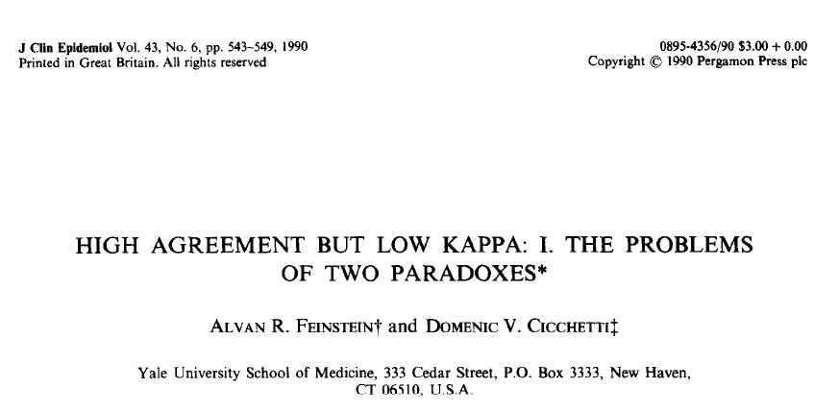
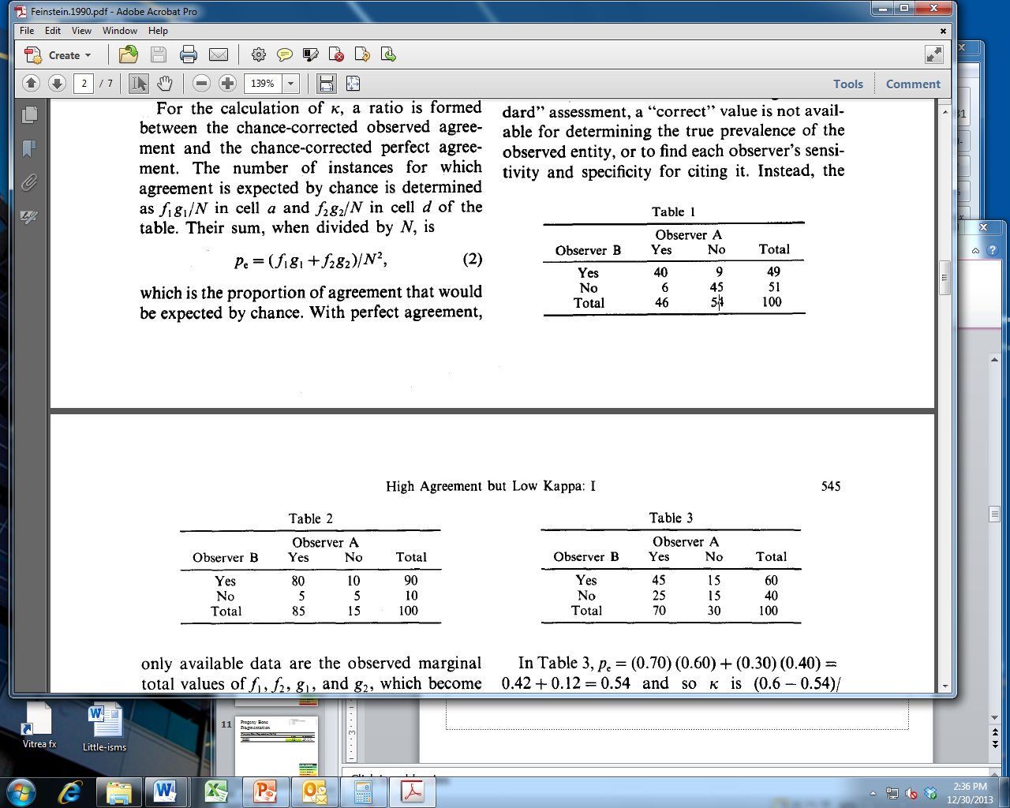
% agreement = 85% (85/100)
kappa = 0.70
% agreement = 85% (85/100)
kappa = 0.32

Slide 10
Progeny Bone
Visibility
Progeny Bone Visibility (Yes/No)
 | Κappa | % Agreement
INTERRATER | 0.45 | 36% (16/45)
INTRARATER | 0.67 | 85% (267/315)
Kappa Agreement
0.81-1 = excellent
0.61-0.8 = substantial
0.41-0.6 = moderate
0.21-0.4 = fair
0-0.2 = slight

Slide 11
Progeny Bone
Fragmentation
Progeny Bone Fragmentation (Yes/No)
 | Κappa | % Agreement
INTERRATER | 0.54 | 50% (8/16)
INTRARATER | 0.64 | 86% (153/177)
Kappa Agreement
0.81-1 = excellent
0.61-0.8 = substantial
0.41-0.6 = moderate
0.21-0.4 = fair
0-0.2 = slight

Slide 12
Progeny Bone
Displacement
Progeny Bone Displacement (None/Partial/Total)
 | ICC | % Agreement
INTERRATER | 0.52 | 13% (2/16)
 | Kappa | % Agreement
INTRARATER | 0.80 | 91% (161/177)
Kappa Agreement
0.81-1 = excellent
0.61-0.8 = substantial
0.41-0.6 = moderate
0.21-0.4 = fair
0-0.2 = slight

Slide 13
Progeny Bone
Center Radiodensity
Progeny Bone Center Radiodensity (More/Same/Less)
 | ICC | % Agreement
INTERRATER | 0.52 | 25% (4/16)
 | Kappa
INTRARATER | 0.57 | 75% (133/177)
Kappa Agreement
0.81-1 = excellent
0.61-0.8 = substantial
0.41-0.6 = moderate
0.21-0.4 = fair
0-0.2 = slight
ICC Agreement
0.75-1 = excellent
0.60-0.75 = good
0.40-0.59 = fair
0-0.39 = poor

Slide 14
Progeny Bone
Center Radiodensity
Progeny Bone Center Radiodensity (More/Same/Less)
 | ICC | % Agreement
INTERRATER | 0.52 | 25% (4/16)
 | Kappa
INTRARATER | 0.57 | 75% (133/177)
Progeny Bone Center Radiodensity (More/LessORSame)
 | Κappa | % Agreement
INTERRATER | 0.68 | 63% (10/16)
INTRARATER | 0.27 | 90% (160/177)
Progeny Bone Center Radiodensity (Less/MoreORSame)
 | Κappa | % Agreement
INTERRATER | 0.64 | 56% (9/16)
INTRARATER | 0.65 | 83% (147/177)
Kappa Agreement
0.81-1 = excellent
0.61-0.8 = substantial
0.41-0.6 = moderate
0.21-0.4 = fair
0-0.2 = slight
ICC Agreement
0.75-1 = excellent
0.60-0.75 = good
0.40-0.59 = fair
0-0.39 = poor

Slide 15
Progeny Bone
Rim Radiodensity
Progeny Bone Rim Radiodensity (More/Same/Less)
 | ICC | % Agreement
INTERRATER | 0.11 | 0% (0/16)
 | Kappa | % Agreement
INTRARATER | 0.32 | 66% (116/177)
Kappa Agreement
0.81-1 = excellent
0.61-0.8 = substantial
0.41-0.6 = moderate
0.21-0.4 = fair
0-0.2 = slight
ICC Agreement
0.75-1 = excellent
0.60-0.75 = good
0.40-0.59 = fair
0-0.39 = poor

Slide 16
Progeny Bone
Rim Radiodensity
Progeny Bone Rim Radiodensity (More/Same/Less)
 | ICC | % Agreement
INTERRATER | 0.11 | 0% (0/16)
 | Kappa | % Agreement
INTRARATER | 0.32 | 66% (116/177)
Progeny Bone Rim Radiodensity (More/LessORSame)
 | Κappa | % Agreement
INTERRATER | 0.61 | 50% (8/16)
INTRARATER | 0.14 | 90% (159/177)
Progeny Bone Rim Radiodensity (Less/MoreORSame)
 | Kappa | % Agreement
INTERRATER | 0.01 | 0% (0/16)
INTRARATER | 0.36 | 70% (124/177)
Kappa Agreement
0.81-1 = excellent
0.61-0.8 = substantial
0.41-0.6 = moderate
0.21-0.4 = fair
0-0.2 = slight
ICC Agreement
0.75-1 = excellent
0.60-0.75 = good
0.40-0.59 = fair
0-0.39 = poor

Slide 17
Progeny Bone
Boundary
Progeny Bone Boundary (Distinct/Indistinct)
 | Κappa | % Agreement
INTERRATER | 0.62 | 63% (10/16)
INTRARATER | 0.55 | 79% (140/177)
Kappa Agreement
0.81-1 = excellent
0.61-0.8 = substantial
0.41-0.6 = moderate
0.21-0.4 = fair
0-0.2 = slight

Slide 18
Progeny Bone
Shape
Progeny Bone Shape (Convex/Linear/Concave)
 | ICC | % Agreement
INTERRATER | 0.33 | 38% (6/16)
 | Kappa | % Agreement
INTRARATER | 0.53 | 77% (137/177)
Kappa Agreement
0.81-1 = excellent
0.61-0.8 = substantial
0.41-0.6 = moderate
0.21-0.4 = fair
0-0.2 = slight
ICC Agreement
0.75-1 = excellent
0.60-0.75 = good
0.40-0.59 = fair
0-0.39 = poor

Slide 19
Progeny Bone
Shape
Progeny Bone Shape (Convex/Linear/Concave)
 | ICC | % Agreement
INTERRATER | 0.33 | 38% (6/16)
 | Kappa | % Agreement
INTRARATER | 0.53 | 77% (137/177)
Progeny Bone Shape (Convex/LinearORConcave)
 | Κappa | % Agreement
INTERRATER | 0.55 | 44% (7/16)
INTRARATER | 0.58 | 81% (144/177)
Progeny Bone Shape (Concave/LinearORConvex)
 | Κappa | % Agreement
INTERRATER | 0.65 | 56% (9/16)
INTRARATER | 0.47 | 83% (147/177)
Kappa Agreement
0.81-1 = excellent
0.61-0.8 = substantial
0.41-0.6 = moderate
0.21-0.4 = fair
0-0.2 = slight
ICC Agreement
0.75-1 = excellent
0.60-0.75 = good
0.40-0.59 = fair
0-0.39 = poor

