Slide 1
HPI
39 yr. old male
R knee pain + 1 yrs with occasional locking
Pain is entirely medial
Work injury 8 years ago, underwent loose body removal and abrasion chondroplasty, did well for 6.5 years. Had pain however since teenager in that knee.
Heavy laborer
6’; 227 lbs, BMI 30.8
Failed injections and PT

Slide 2
ROCK Complex Case of the Month
Justin S. Yang MD
Southern California Permanente Medical Group

Slide 3
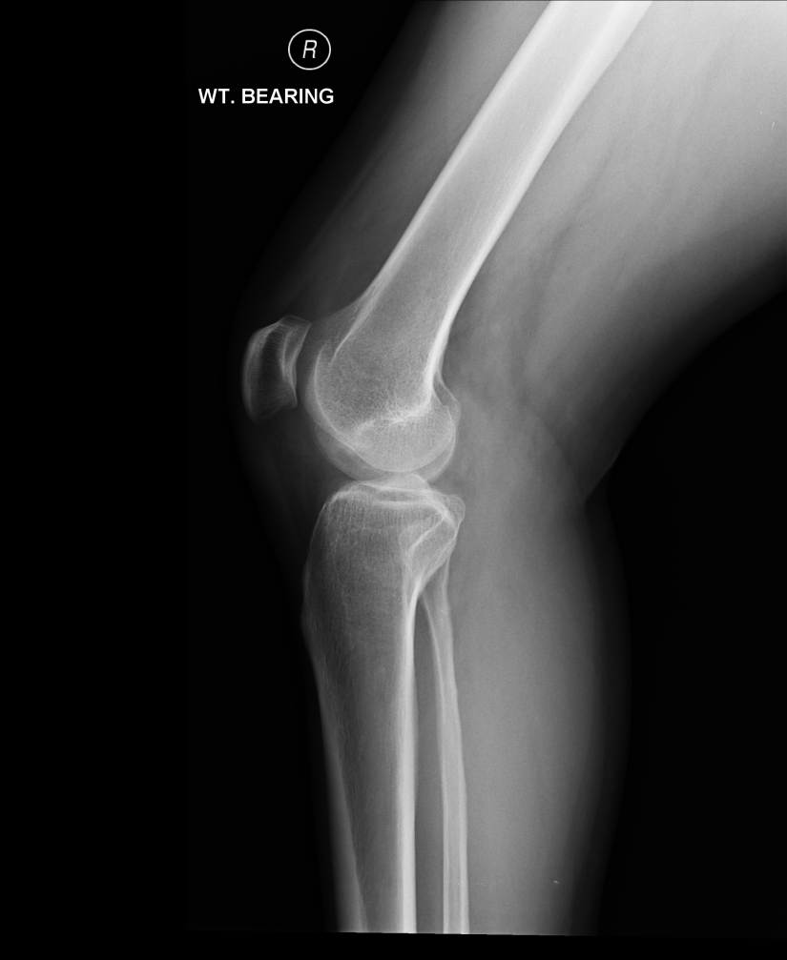

Slide 5
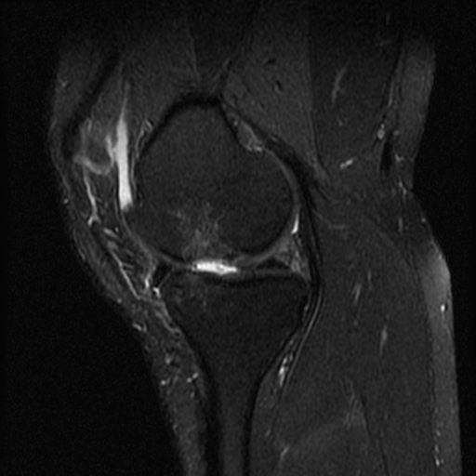
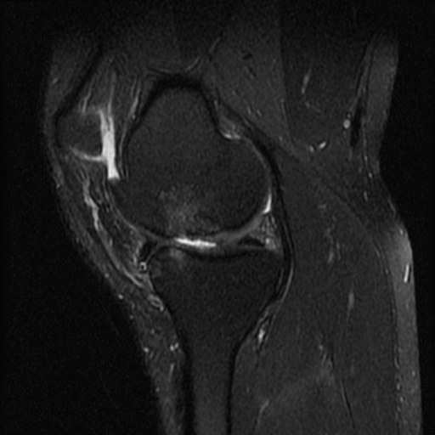
Sagittal MFC

Slide 6
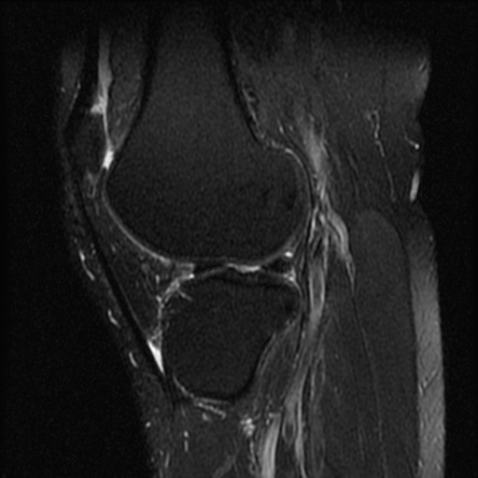
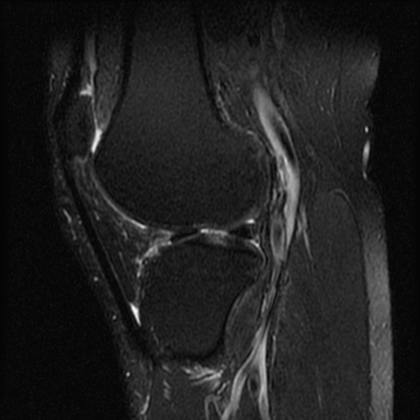
Sagittal LFC

Slide 7
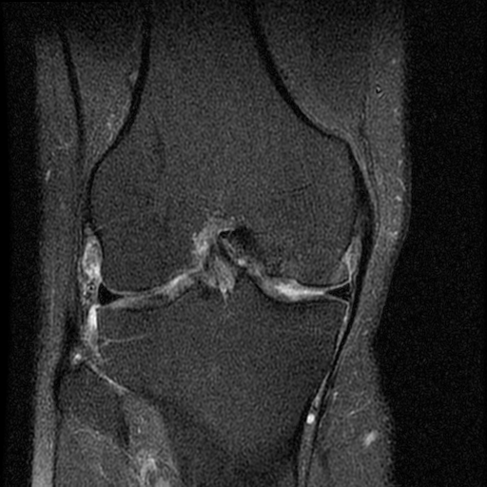
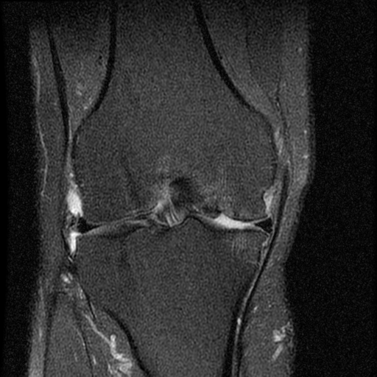
Coronals

Slide 8
Measurements
Measures 18mm x 16mm on MRI
Alignment is zone 2 on the right side, zone 3 on the left side

Slide 9
Plan
Currently awaiting allograft match
Plan on HTO and allograft OATs

Slide 10
Questions
Would you do anything to the lateral femoral condyle lesion?
Would you correct his alignment back to neutral or into the lateral compartment?
Does his BMI/weight concern you? What is your BMI/weight limit for this procedure?
Would you consider any other procedures as an alternative (microfracture/biocartilage, Cartiform, DeNovo, ACI, unicondylar arthroplasty?)

