Slide 1
ROCK Case of the Month March 2015
Jeffrey J. Nepple
Washington University Orthopaedics
Robert F. LaPrade
Steadman Clinic

Slide 2
Case
11 + 5 yo M
R lateral knee pain
1.5 years (10 yo)
Football injury – “normal” xray
MRI obtained

Slide 3
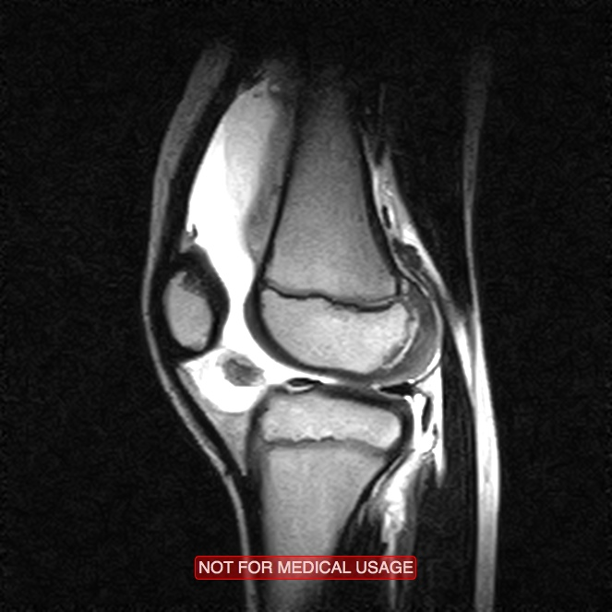
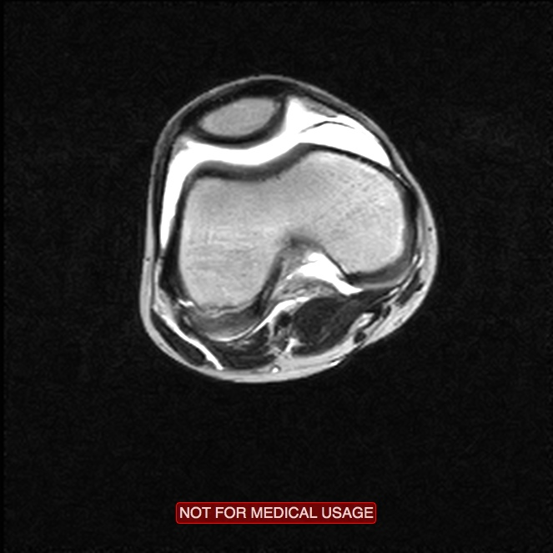
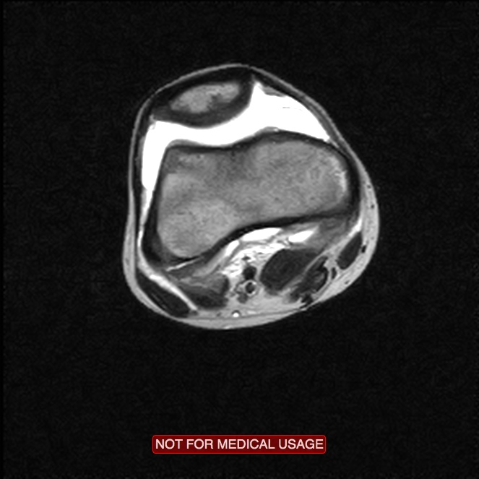
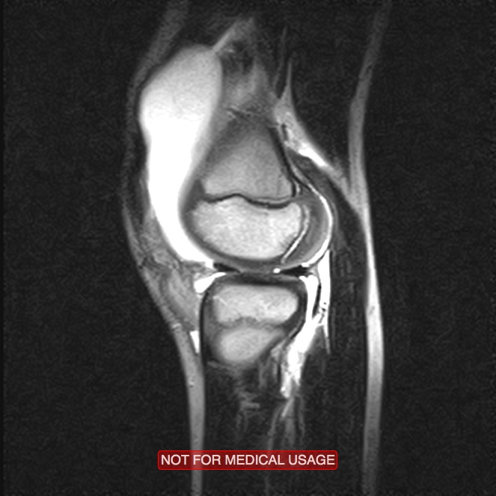
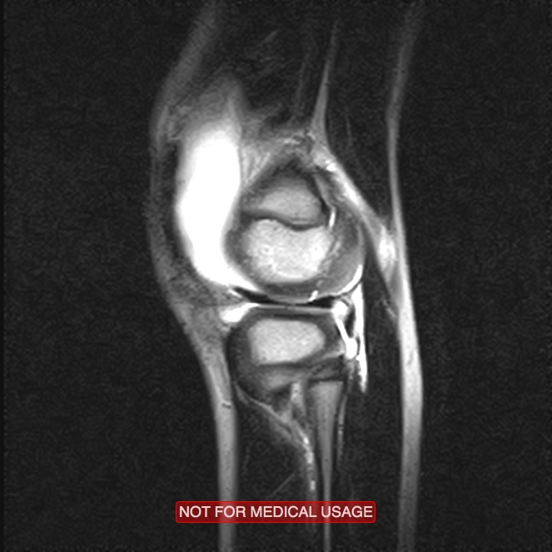
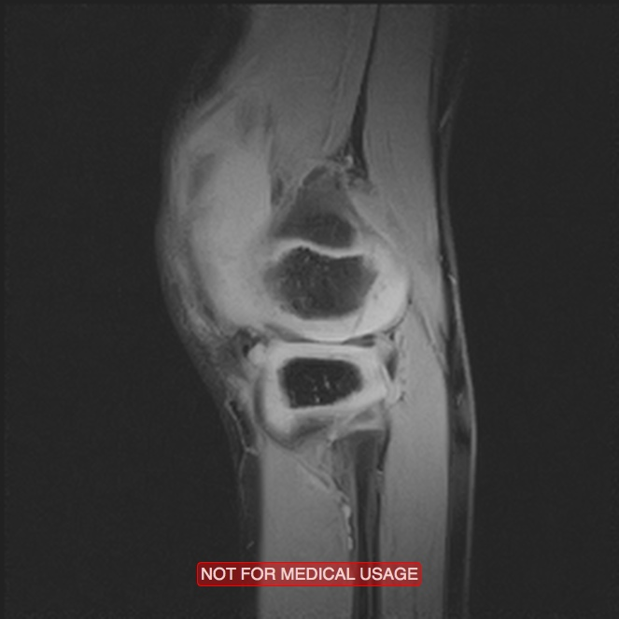
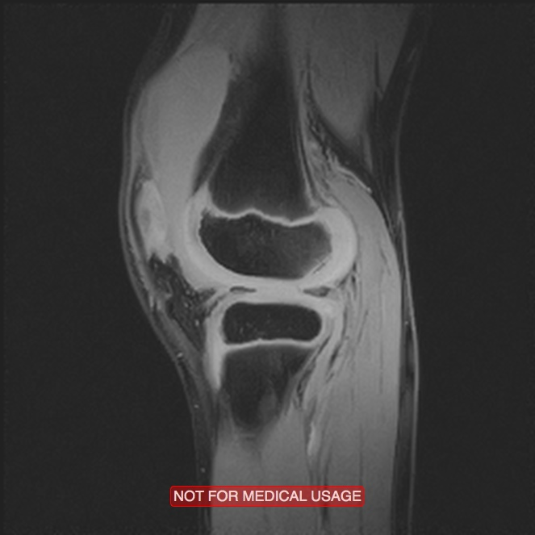
Initial MRI

Slide 4
Treated as “knee sprain” per family
Continued pain with sports
Mechanical symptoms

Slide 5
9 months after injury

Slide 6
Subsequently treated with extended periods of weightbearing restriction, activity restriction, bracing

Slide 7
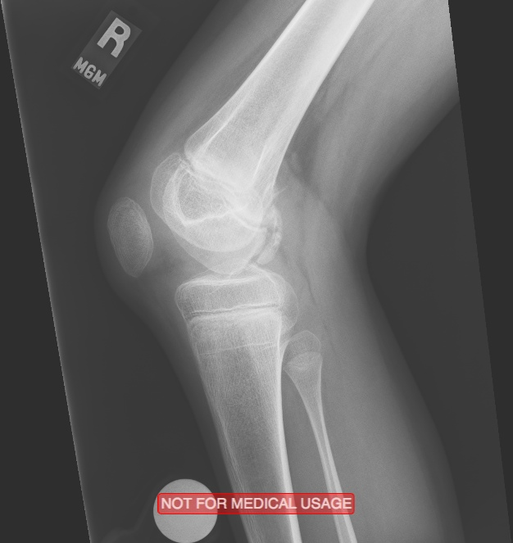
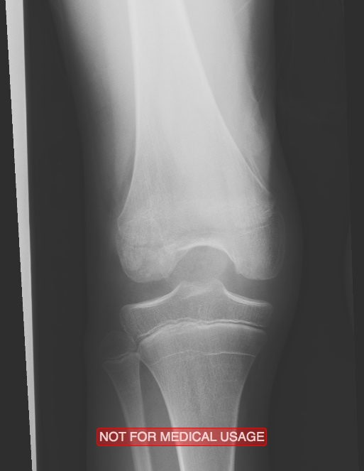
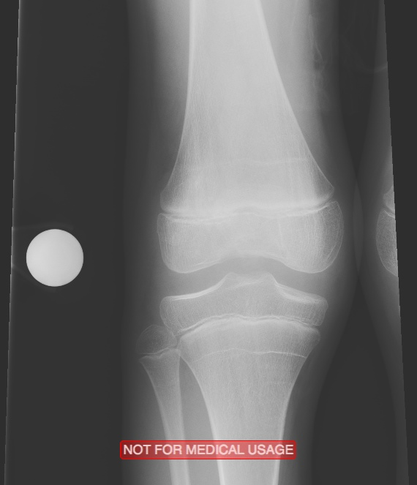
1.5 years after injury

Slide 8
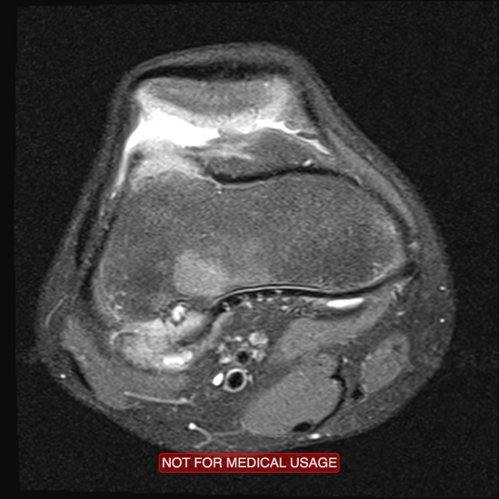
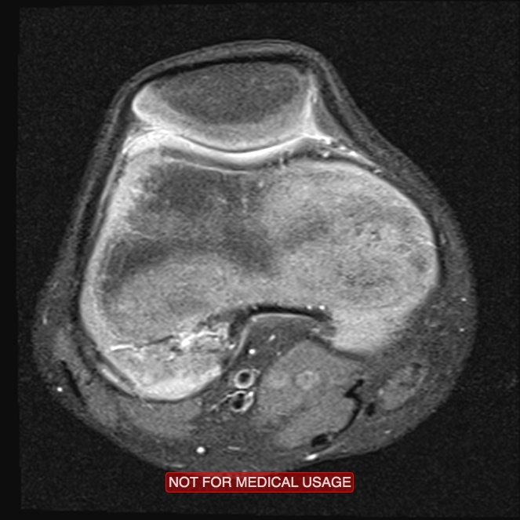
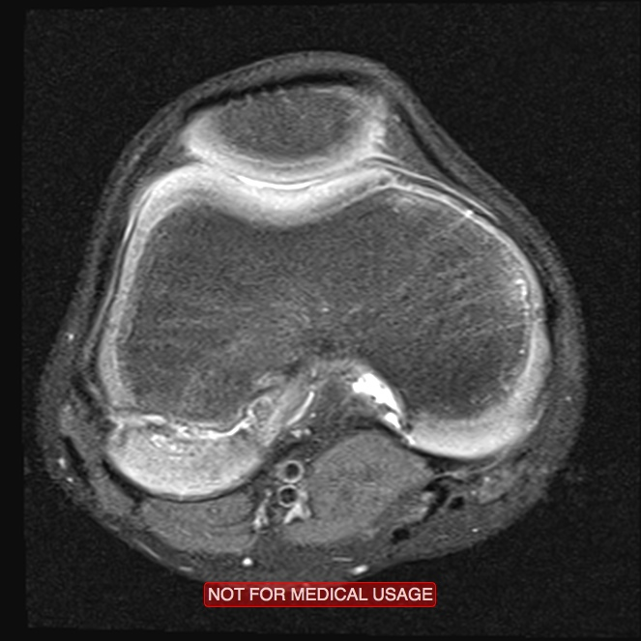
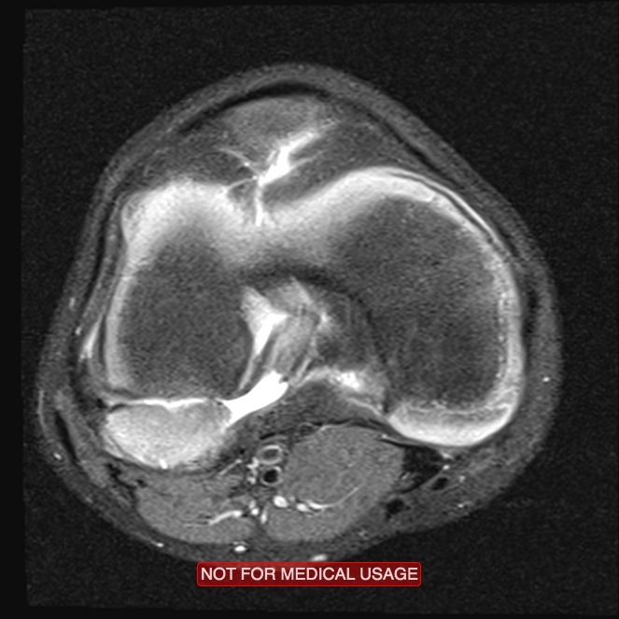
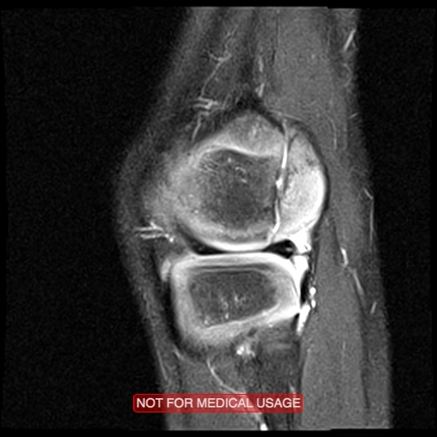
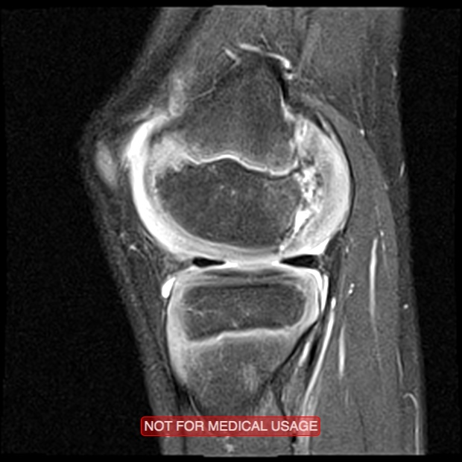
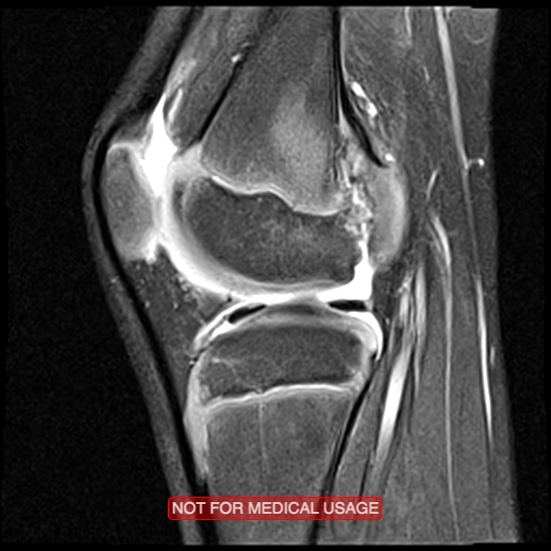
Repeat MRI

Slide 9
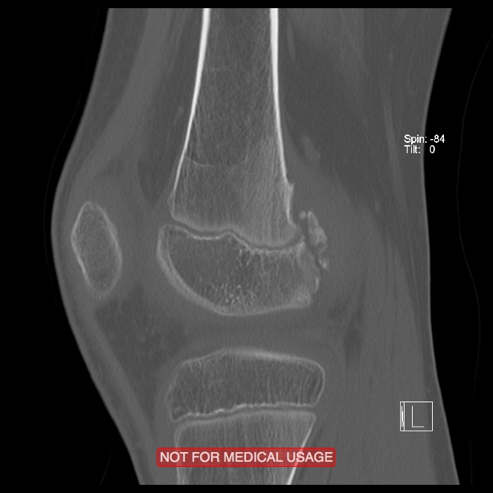
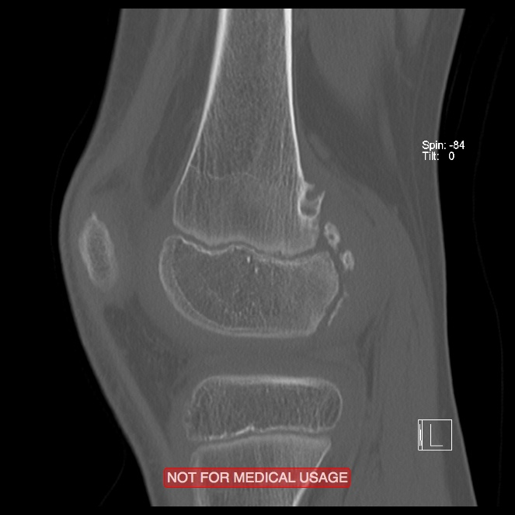
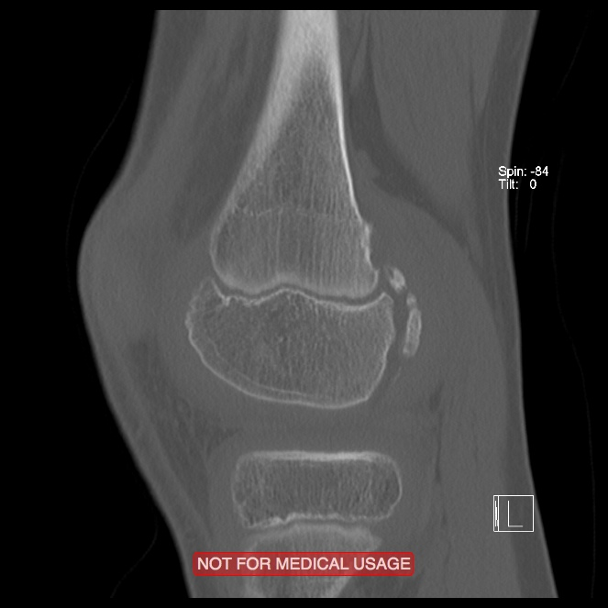
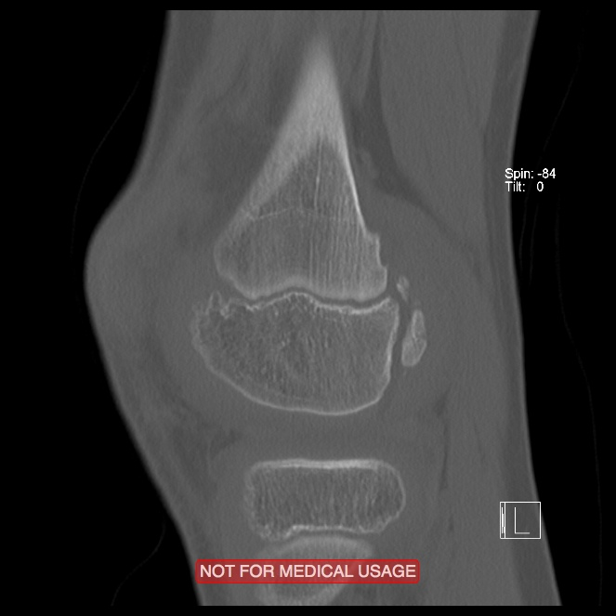
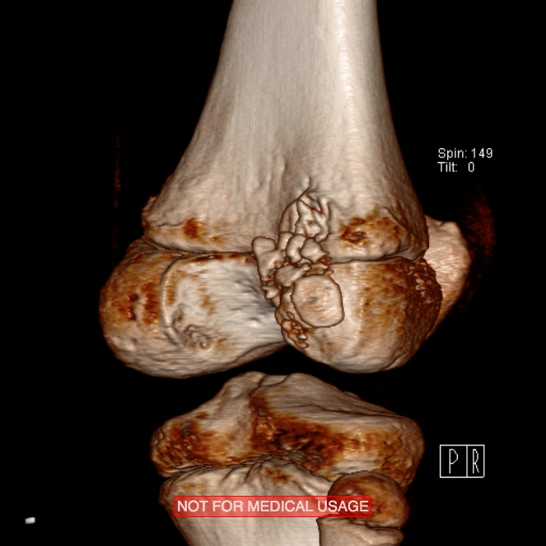
CT

Slide 10
Etiology?
Treatment?
Approach?
Fixation?

Slide 11
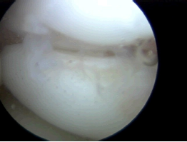
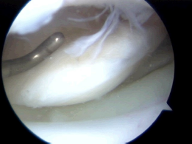
Arthroscopy

Slide 12
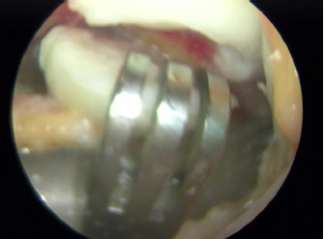
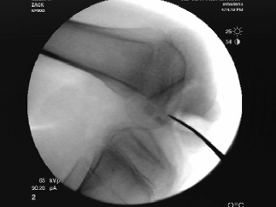
Open Fixation
Lateral peripatellar arthrotomy
Knee hyperflexion

Slide 13
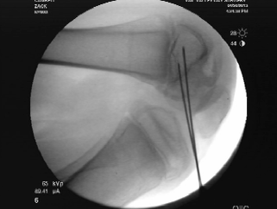
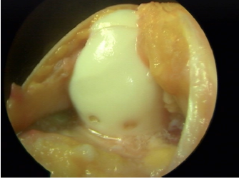
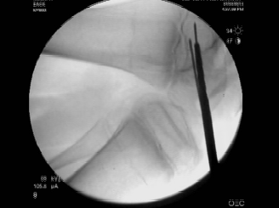
Open Fixation
Debridement
Proximal tibia bone grafting
Bioabsorbable screw fixation

Slide 14
Postop
NWB 6 weeks
Lateral unloader brace
No ROM restrictions

Slide 15
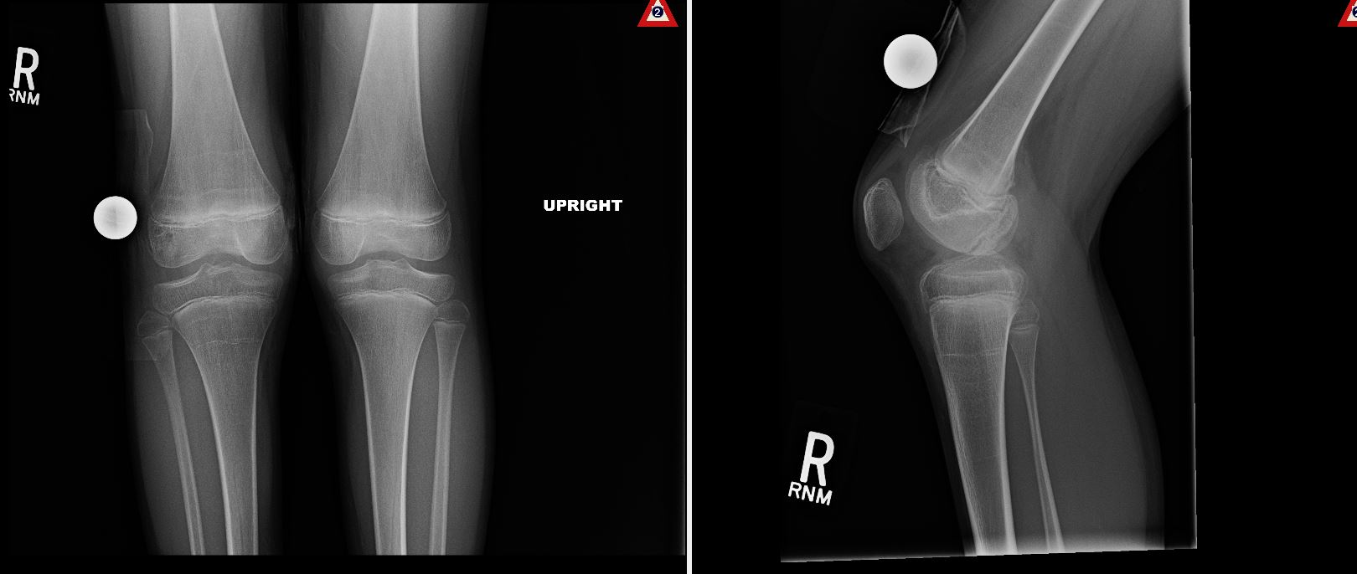
1 year postop
Pain free
MRI obtained prior to return to full sports
PRE

Slide 16
PRE

