Slide 1
Patient
17 yo Female Right knee pain
s/p resection R distal femoral vascular malformation (8/2008)
Did well immediately post-op
Progressively developed increasing Right knee pain/mechanical symptoms
MRI 10/2009: osteochondral lesion LFC, multiple loose bodies
R knee arthroscopic LB removal, drilling LFC osteochondral defect (1/2010)
Had continued knee pain; also noted to develop progressive genu valgus
Referred to Dr. Davidson for evaluation of genu valgus
PMH: None

Slide 2
Scanogram 4/2014
Right 13⁰ genu valgus
Left 8⁰ genu valgus
Right lat DFA = 79⁰
Left lat DFA = 84⁰

Slide 3
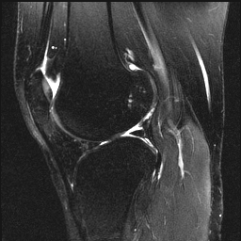
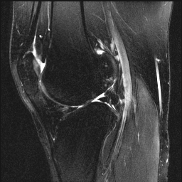
MRI Right knee 4/2014

Slide 4
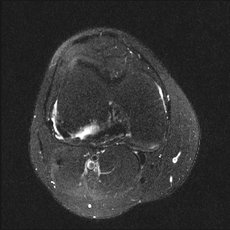
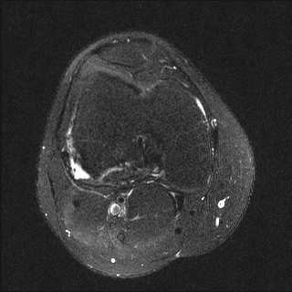
MRI Right knee 4/2014

Slide 5
Patient
Planned Operation: Distal femoral opening wedge varus osteotomy, LFC ACI
Approach
Straight lateral for distal femoral osteotomy/fixation
Fixed with locking lateral distal femoral plate (Synthes TomoFix, stainless)
Lateral parapatellar arthrotomy for LFC chondral lesion
Hyperflexion of knee for exposure posterior LFC lesion
Autologous chondrocyte implantation per standard technique

Slide 6
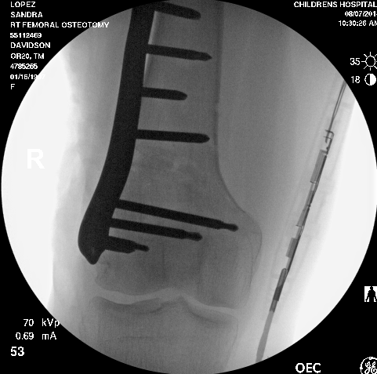
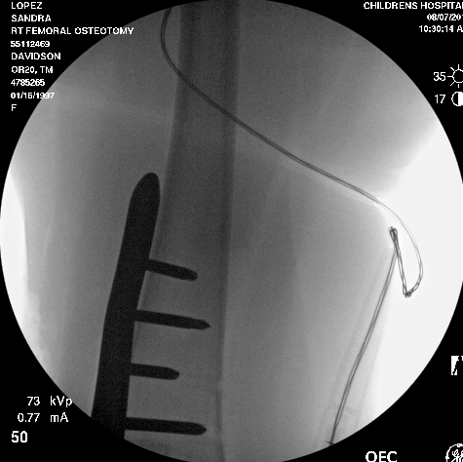
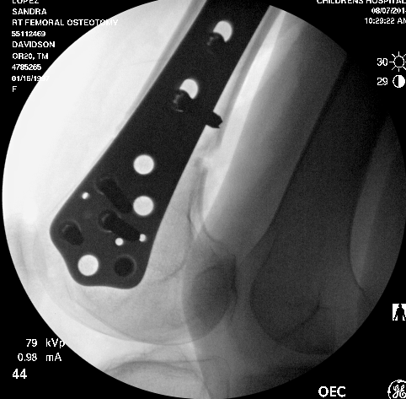
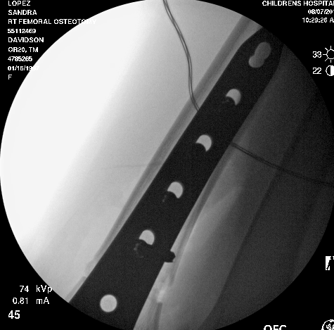

Slide 7
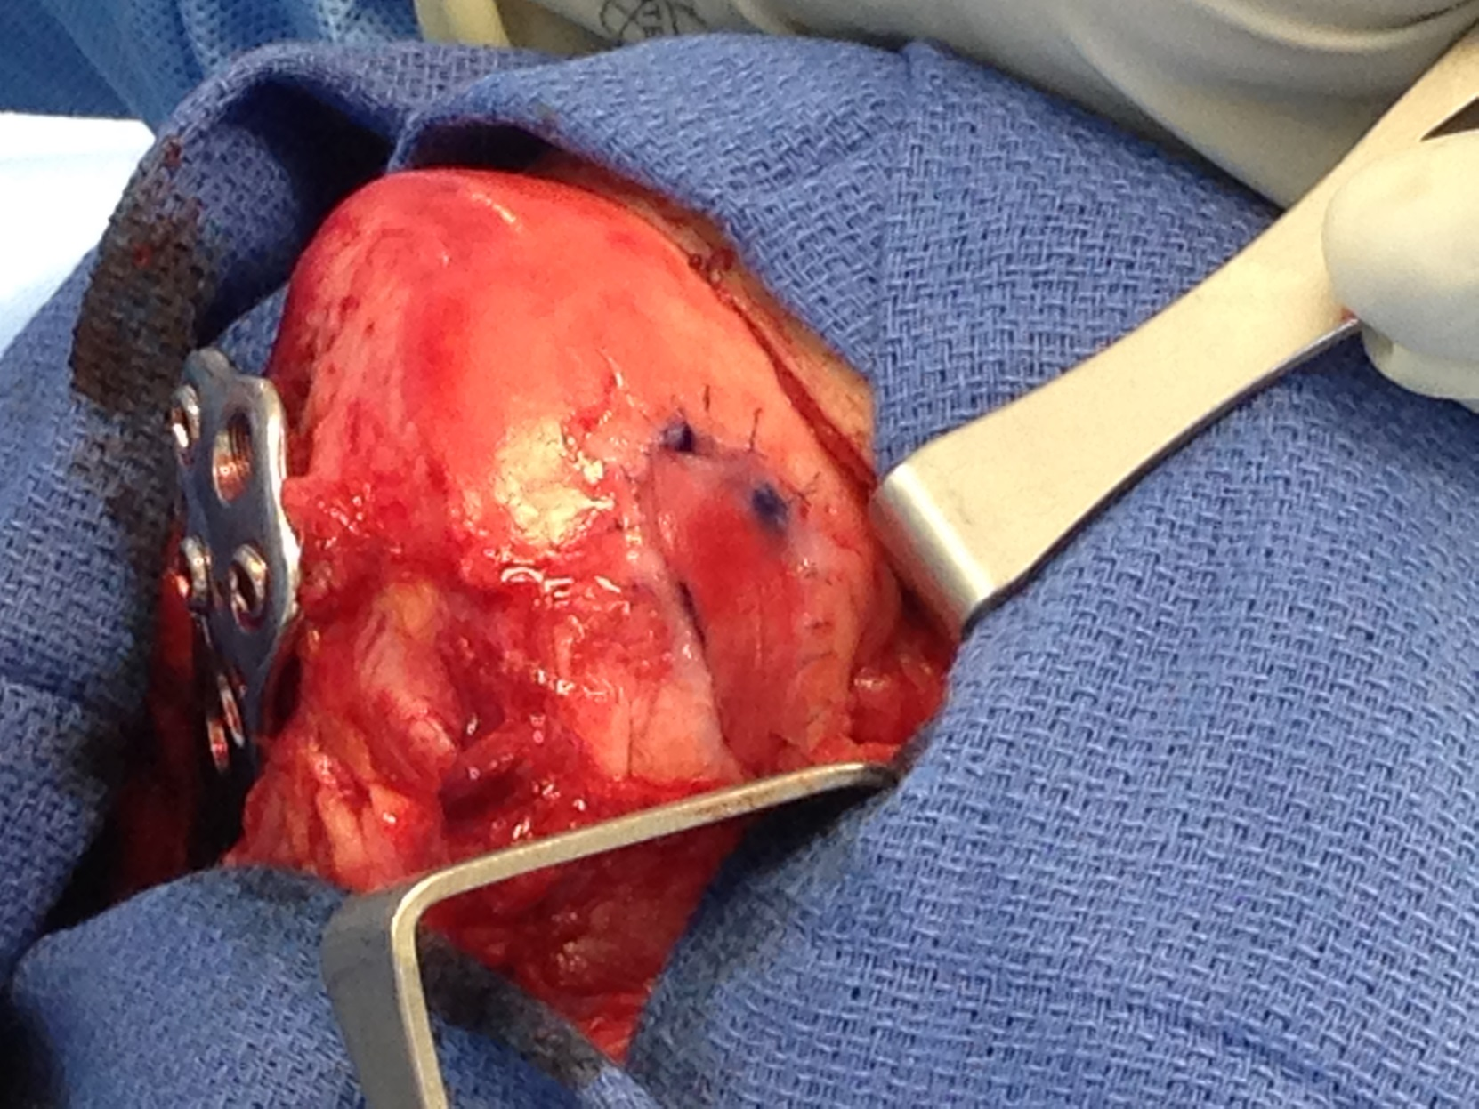

Slide 8
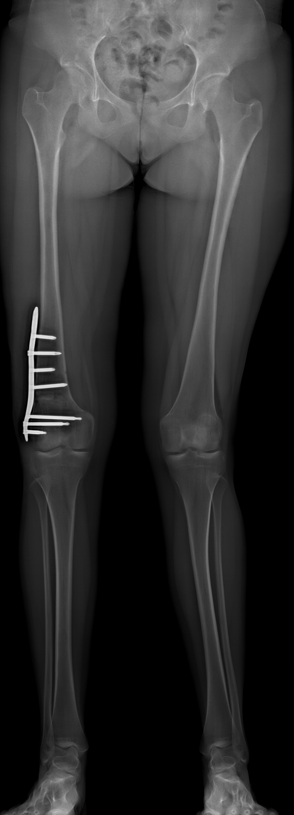
6 weeks post-op

